Slide 1
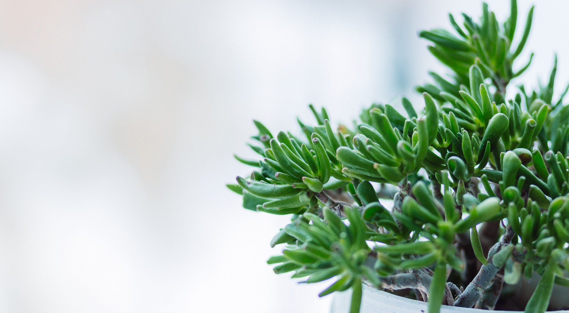
The Economics of Biophilic Design
Why Designing With Nature Makes Financial Sense
Notes:
Hello, and thanks for downloading this information.
To support people and companies with a vision of the future in which preserving access to nature and interior landscaping is more relevant than ever, Green Plants for Green Buildings has created an edited version of our continuing education course, The Economics of Biophilic Design. It looks at the science behind the crucial role nature plays in maintaining our wellbeing, and includes research data from five sectors (education, health care, retail, workplace, and communities) on the impact biophilic design has on health, productivity and profits. We hope you’ll share this compelling information with your teams and create talking points for your client conversations.
Bear in mind: 1. This edited course is part of the GPGB Registered Trainer curriculum and is written as if you, the reader, are making this presentation. 2. This material will not confer to you Registered Trainer status. If you are interested in this, visit https://greenplantsforgreenbuildings.org/become-a-trainer/ for more information, or call us at 707-467-9417.
Be well and #StayPlanted!

Slide 2
This presentation is protected by copyright.
Protected by US and International copyright laws, reproduction, distribution, display and use of the presentation without written permission of Green Plants for Green Buildings is prohibited.
© 2018 Green Plants for Green Buildings
This biophilic design information in this presentation is based on Terrapin Bright Green’s The Economics of Biophilia. Research citations and calculations mentioned in this presentation appear on pages 29 – 39 of their publication.
Download a copy from https://greenplantsforgreenbuildings.org/research .
.Photo: Stock Snap
2
Notes:
Green Plants for Green Buildings owns the copyright for this program.
This biophilic design information in this presentation is based on Terrapin Bright Green’s The Economics of Biophilia. Research citations and calculations mentioned in this presentation appear on pages 29 – 39 of their publication.
Download a copy from https://greenplantsforgreenbuildings.org/research .
Photo: Stock Snap

Slide 3
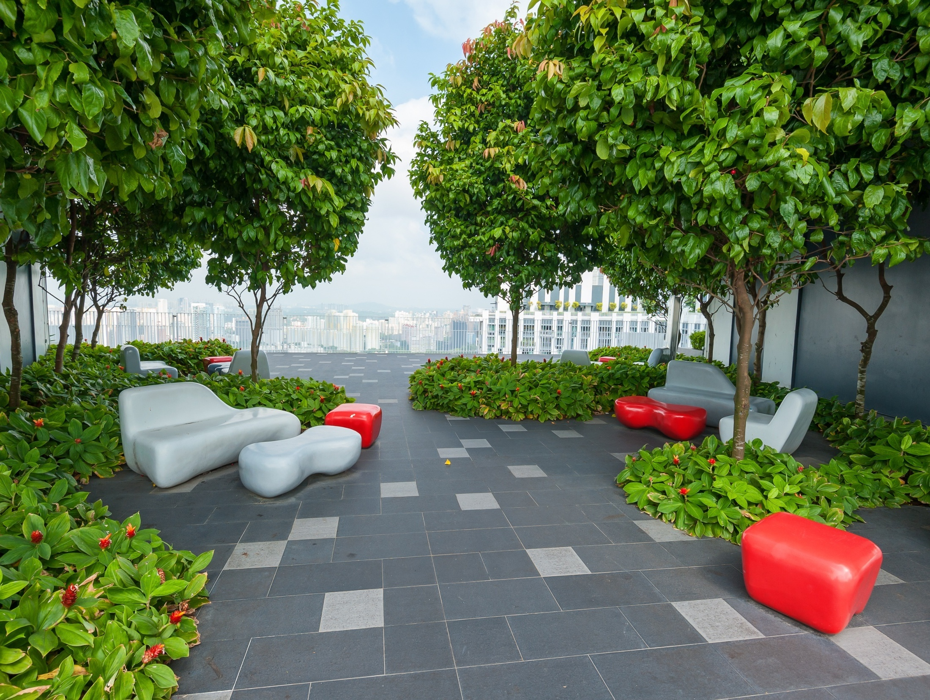
Course Description
This program will examine the economic argument in favor of biophilic design using case studies from five sectors; workplaces, health care, education, retail and communities. Research from neuroscience and endocrinology show the crucial role that experiencing nature has for our physiological well-being. Today we will describe the research involving biophilic design and its impact on human health and productivity.
Notes:
This program will examine the economic argument in favor of biophilic design using case studies from five sectors; workplaces, health care, education, retail and communities. Research from neuroscience and endocrinology show the crucial role that experiencing nature has for our physiological well-being. Today we will describe the research involving biophilic design and its impact on human health and productivity.

Slide 4
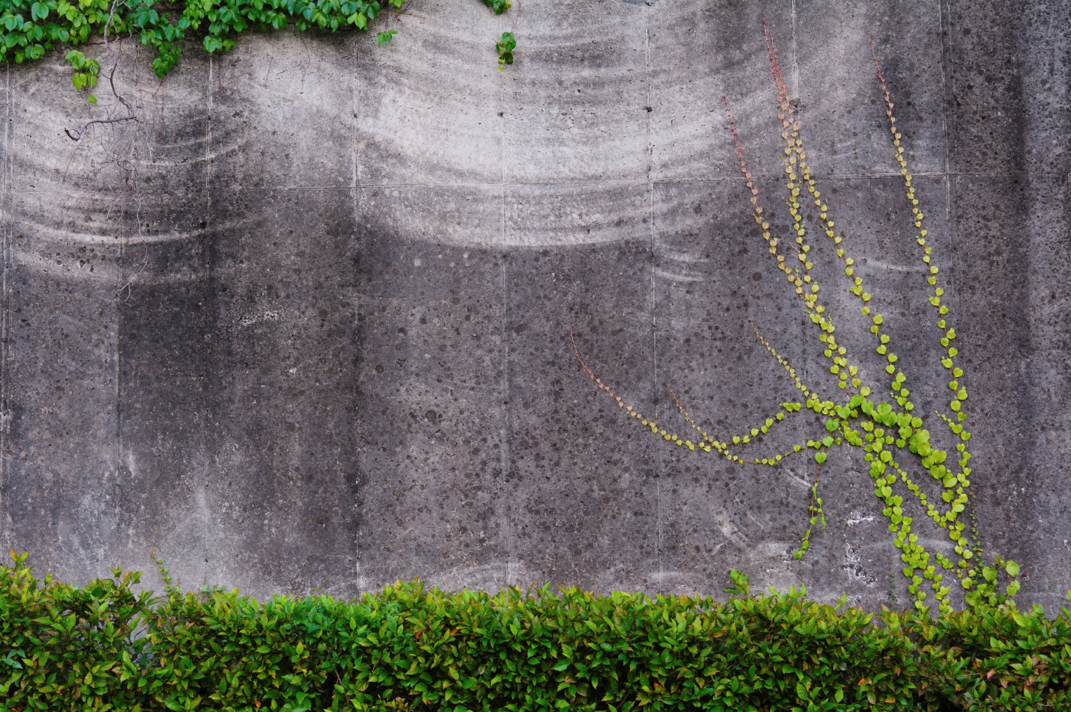
Learning Objectives
#1: Participants will learn what recent science demonstrates regarding human behavioral response to natural environments and stimuli.
#2: Participants will learn to recognize biophilic design patterns and elements.
#3: Participants will learn how human responses to their environment are measured.
#4: Participants will learn how biophilic design profoundly affects the well-being and overall profitability of humans in the modern built environment.
#5: Participants will learn economic values assigned to incorporating biophilic design elements into the built environment.
4
Notes:
Learning Objectives
#1: Participants will learn what recent science demonstrates regarding human behavioral response to natural environments and stimuli.
#2: Participants will learn to recognize biophilic design patterns and elements.
#3: Participants will learn how human responses to their environment are measured.
#4: Participants will learn how biophilic design profoundly affects the well-being and overall profitability of humans in the modern built environment.
#5: Participants will learn economic values assigned to incorporating biophilic design elements into the built environment.

Slide 5
Introducing Biophilia
Notes:
“Life around us exceeds in complexity and beauty more than anything else humanity is ever likely to encounter” – E.O. Wilson

Slide 6
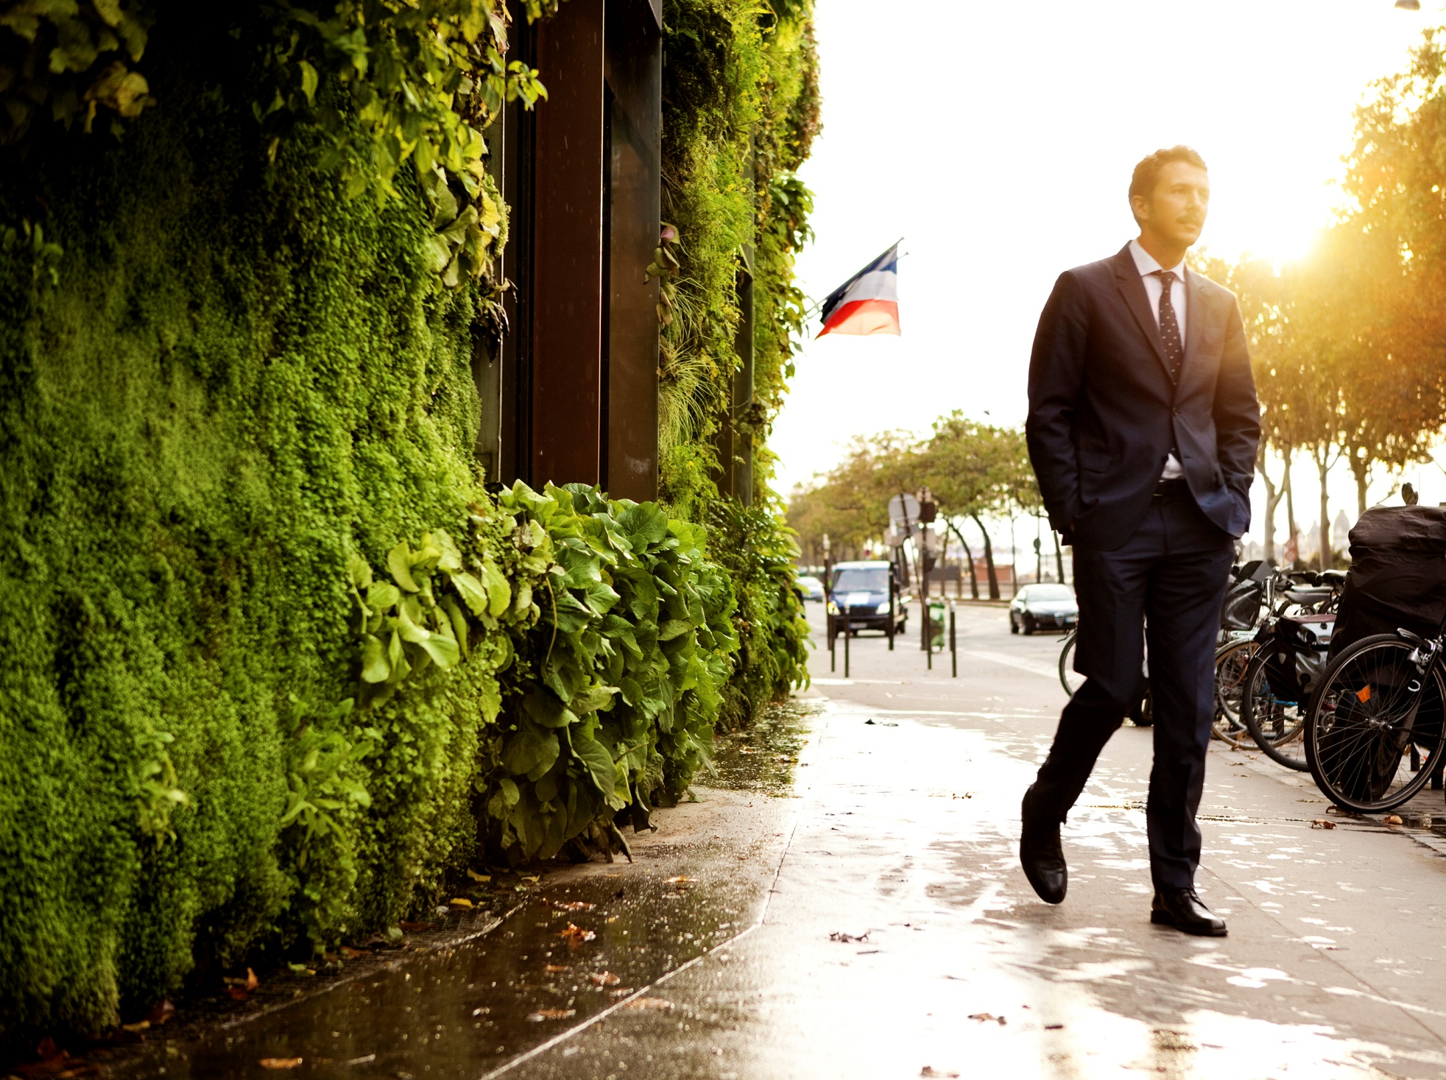
Biophilia
Innate human attraction to nature.
Notes:
Biophilia when translated from Latin means “love of life or living systems”.
Biophilia as a hypothesis was first expressed by German social psychologist Erich Fromm in 1964 and later popularized by American biologist EO Wilson, in his 1984 publication ‘Biophilia’.
Wilson’s description was “Biophilia is the innately emotional affinity human beings have for other living organisms. Innate means hereditary and hence part of ultimate human nature.” – E.O Wilson
Over the last three decades the scientific and design communities have begun to recognize biophilia and perform experiments designed to prove or disprove the hypothesis. And the research evidence is flooding in. Scientists are proving that biophilia , the innate human attraction to nature, is not a theory, is not a hypothesis, but is indeed fact.
And this makes such sense! Humanity has spent 95% of its evolutionary history in the embrace of the natural environment. We are hardwired to respond to the stimuli of our natural surroundings.
Biophilia implies that humans hold a biological need for connecting with nature on physical, mental, and social levels, and that this connection affects our personal well-being, productivity, and societal relationships.

Slide 7
Contact with nature is essential for human health
Notes:
To increase our comfort and productivity, humans have traditionally improved the places in which we live and work.
Technological advancements in building design have improved the health and welfare of building occupants, and paid little attention to our physiological needs.
Recent advancements in our understanding of the subtle neurological and physiological functions associated with exposure to nature have allowed us to identify strategies to improve productivity, strengthen the social fabric of communities and increase economic gains.
While biophilia’s cognitive benefits have been well documented, the economic benefits of biophilic design remain relatively under-documented.
And sharing some of these economic benefits with you is what I’d like to do here today.

Slide 8
Why Do We Need Biophilia?
Urbanization has increased
Stress
Crime
Absenteeism
Depression
While decreasing productivity and learning.
Notes:
As of 2007, the majority of the human beings around the globe, are urban dwellers, despite having spent 95% of our evolutionary history in natural environments. The migration to cities has only occurred within the last 200 years and our bodies and minds have been unable to adapt to such a drastic change in our environments.
Urbanization has brought with it higher levels of stress, crime, depression and lower levels of productivity and learning, sometimes in the forms of absenteeism and presenteeism.
In regards to this lower level of productivity, did you know that in the workplace, the loss of productivity costs are 10 times greater than energy costs?
Considering this, it can be concluded that incorporating nature into the built environment is not just a luxury, but a sound economic investment for anyone in the business of managing people.
We’re not going to be able to turn back the rural exodus. We need to make our cities and urban environments more livable. This can be achieved in part through greater access to nature which restores and enhances our mental health and well-being.

Slide 9
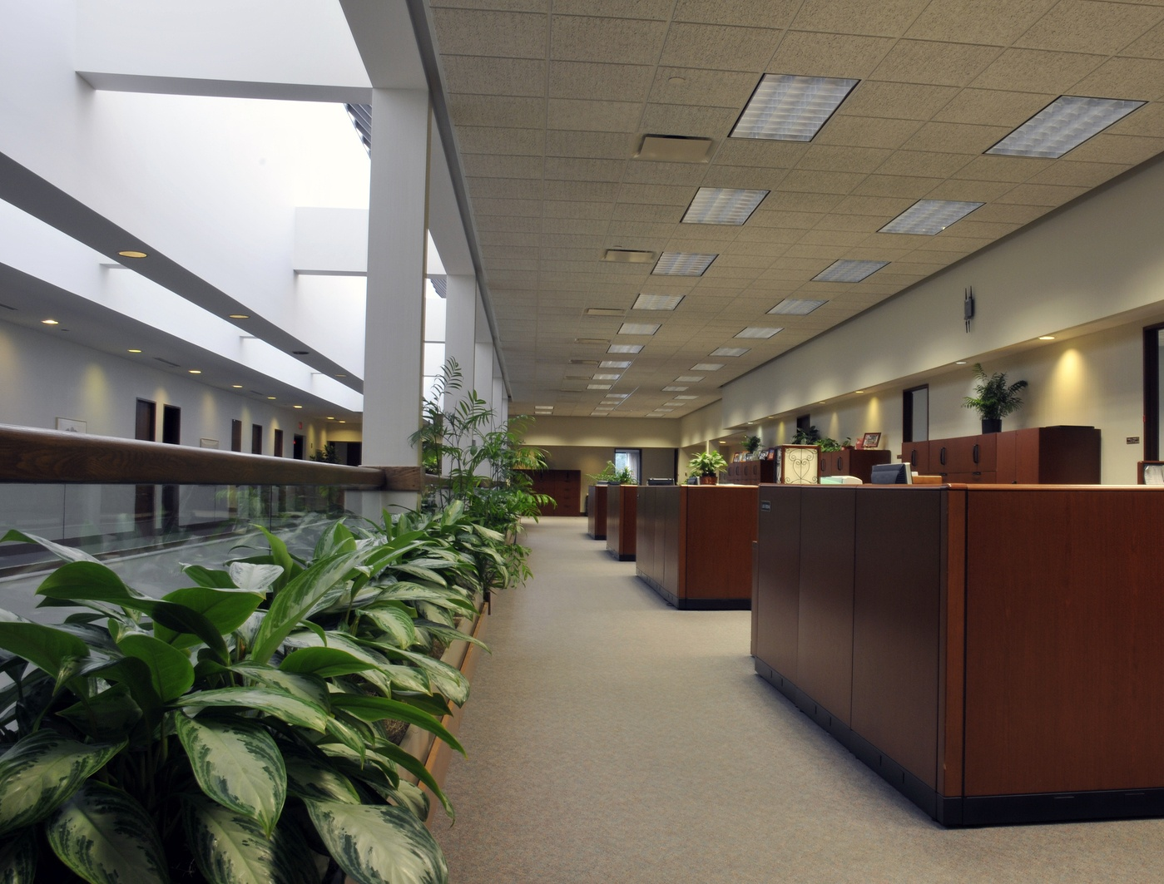
A Way to Improve Profits
RESEARCH RESULTS FROM Workplaces – Health care – Retail – Schools - Communities
Notes:
Today’s presentation will
make the connection between biophilic design and human well-being,
examine how productivity, health, and well-being can be measured
and translate those measurements into economic savings and gains.
We wish to demonstrate the economic value of paying attention to biophilic design as a way to improve profits. While some perceive plants as a luxury, the science says they are a way to improve profits.

Slide 10
The Science Stuff

Slide 11
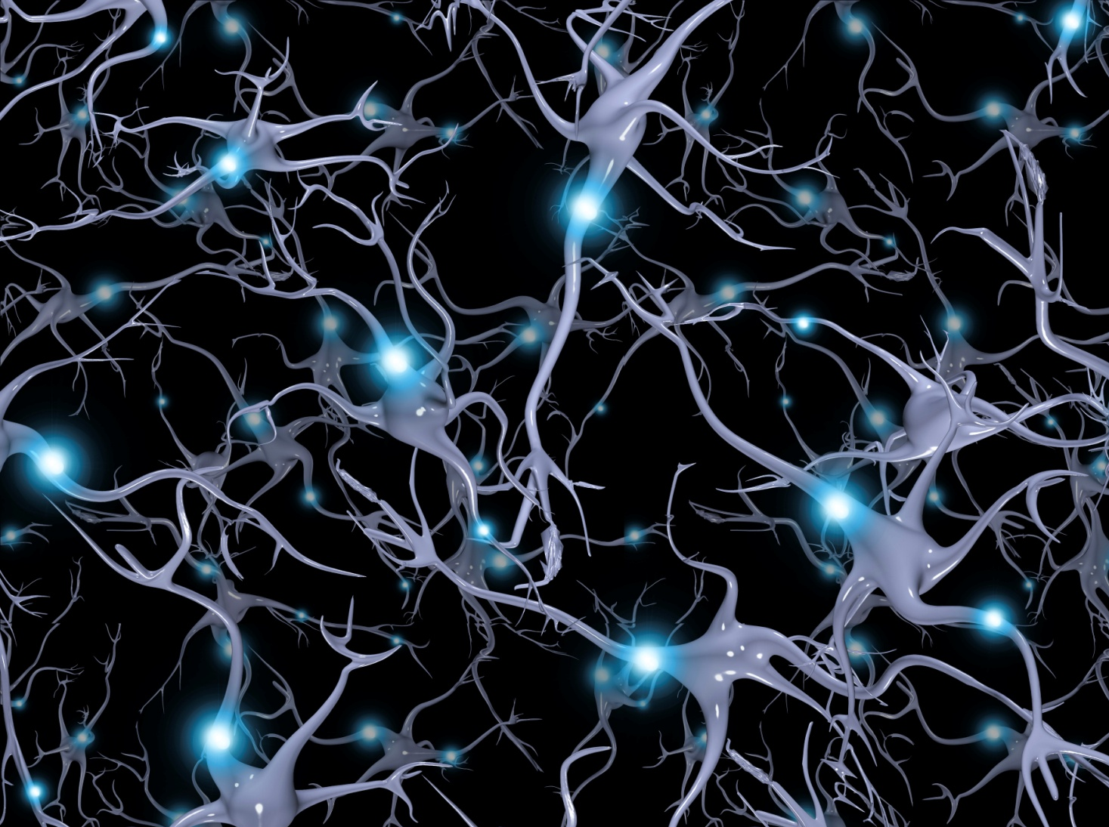
How Does Biophilia Affect Us?
Interaction with nature is essential in regulating the autonomic nervous system integrating the mind and body.
Sympathetic system controls cognitive function
Parasympathetic system controls relaxation
CASE STUDIES CONCLUSIONS – Access to nature
Decreases stress and irritability
Increases concentration
Notes:
There is a neurological and physiological basis for biophilia.
The human body’s autonomic nervous system consists of two elements: the sympathetic and the parasympathetic systems.
The sympathetic system stimulates the human body when cognitive function is needed.
The parasympathetic system serves to relax the body, and is used for internal processes such as digestion.
The body is in an ideal state of balance when the natural balance between sympathetic and parasympathetic is achieved. Scientists call this homeostasis.
In non-restorative or chaotic environments, the sympathetic system becomes highly stimulated in a “fight-or-flight” mindset, leading to sensory overload.
When this happens, the parasympathetic system is suppressed, disrupting the body’s physiological regulation, and resulting in mental fatigue. This combination induces stress, frustration, irritability, and distraction.
Studies show that interacting with nature provides an increase in parasympathetic activity, resulting in reduced sympathetic activity. This in turn leads to decreased stress and irritability, and increased levels of concentration.

Slide 12
Urban vs Nature
Viewing nature is a pleasurable experience.
Visually dull scenes can induce stress.
Dynamic movement increases restorative responses.
Notes:
In the large rear portion of our brain’s visual cortex are the mu (opioid) receptors.
When our eyes perceive natural scenes, the mu receptors are highly stimulated, triggering feelings of pleasure. The more dynamic the natural scenes - such as moving water, leaves in a breeze, fish swimming in an aquarium, or a flickering fire - the more our attention is held. This is an environmental and physiological state of being in which creative task performance is increased.
In studies where subjects were exposed to views with less visual richness - such as a blank wall or a tree-less street - less pleasurable mental reactions were triggered, including those associated with stress. (Biederman & Vessel, 2006)

Slide 13
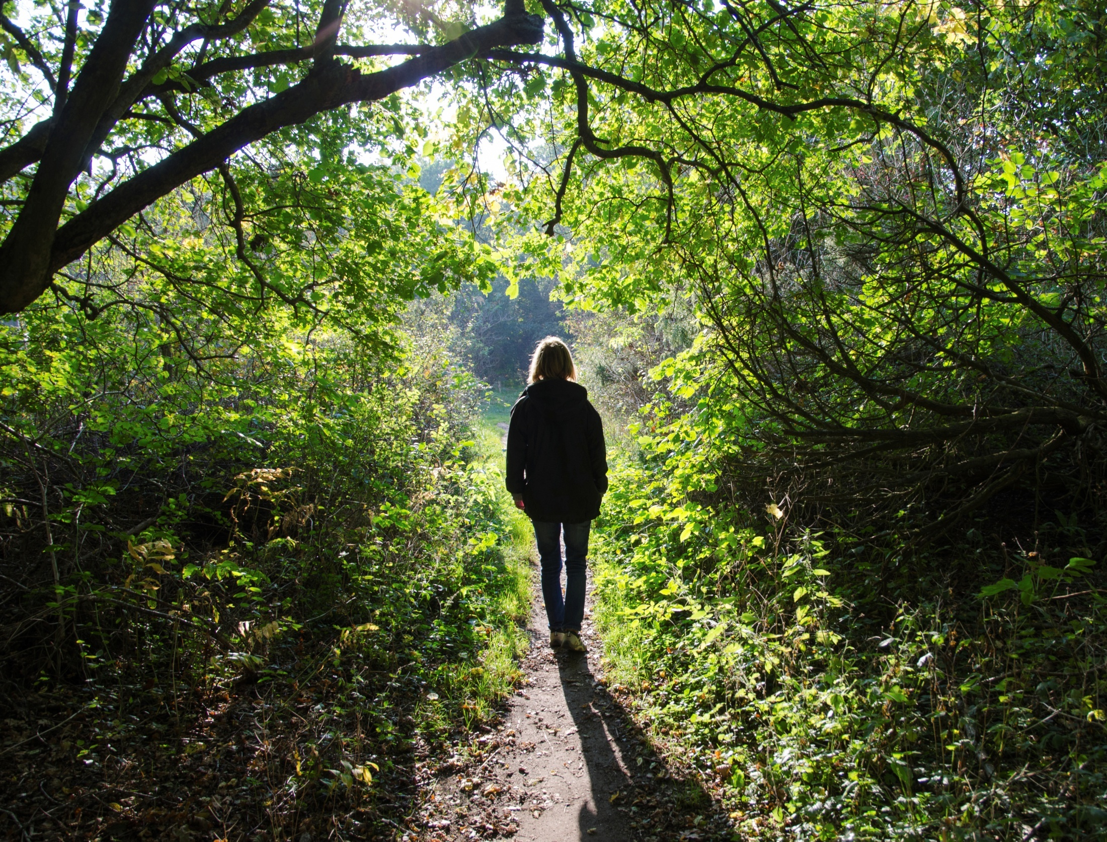
Complex Natural Scenes
CASE STUDIES CONCLUSIONS
Lower pulse rate by 6%
Lower stress hormones by 15%
Lower blood pressure.
Increased parasympathic activity by 56%
Decreased sympathic activity by 19%
Notes:
How did nature affect research subjects?
Studies shows that, when compared to those who walked through urban areas, subjects who walked through forests had
Reduced pulse rate of 3.6-6%
Lower systolic blood pressure
Reduced stress hormone levels by 13.4-15.8%
Increased parasympathetic activity – relaxed by 56%
Decreased sympathetic activity by 19% - remember this is the “fight or flight” reflex

Slide 14
Reducing Stress
Stress causes mental hearth disorders and cardiovascular diseases.
Direct access to nature can alleviate feelings of stress.
Notes:
According to the World Health Organization, cardiovascular diseases, stroke, and mental health disorders are expected to be the top global disease burdens in the years 2020 – 2040. ( Institute for Health Metrics and Evaluation (IHME). Findings from the Global Burden of Disease Study 2017. Seattle, WA: IHME, 2018. )
Stress is a known cause of these disorders.
In America, treatment for cardiovascular disorders accounts for $1 of every $6 spent on healthcare. (CDC, 2011).
The good news is that over and over again, research results indicate that access to nature can alleviate feelings of stress.
In one study, after viewing videos of natural environments and urban environments, test subjects heart beat intervals rates were measured. Those subjects viewing natural environments experienced positive cardiac deceleration and beneficial physiological arousal. (Laumann et al., 2003).

Slide 15
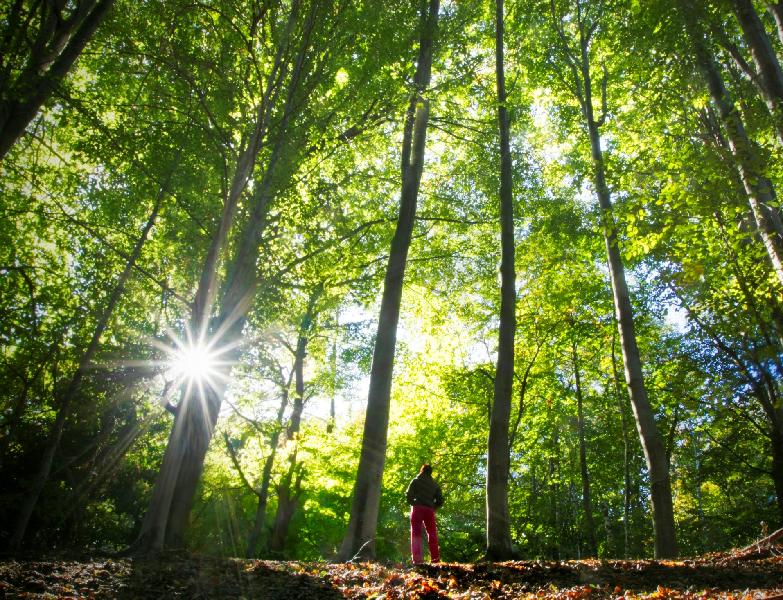
Immersion in Natural Environments
CASE STUDIES CONCLUSIONS – “Forest bathing”
Decreased blood glucose by 39.7%
Increased “NK” (anti-cancer) cell activity
Effects lingered for up to 30 days after Shinrin-yoku.
Notes:
Another field of research surrounding human interactions with nature provides solid evidence of the benefits of natural environments on human health.
Shinrin-yoku is the ancient Japanese practice of restorative walks through natural settings, most often forests.
In English, the direct translation of Shinrin-yoku is “forest bathing”.
Research performed over the course of six years tested Shinrin-yoku’s ability to effectively decrease blood glucose levels in patients who walked 3-6 kilometers in forested areas.
Compared with other forms of exercise, which effectively reduced blood glucose levels by 21.2%, forest bathing decreased blood glucose by an impressive 39.7% (Ohtsuka, 1998).
Forests excrete organic compounds called phytoncides, and as we breath them, human hormonal secretion and autonomic nervous functions are stabilized.
New Shinrin-yoku studies show that inhaling these pungent compounds has tremendous health benefits that are difficult to reap in the urban and built environments.
Such benefits include increased Natural Killer (NK) cell activity (vital for deterring cancer) for up to 30 days after the forest walk.

Slide 16
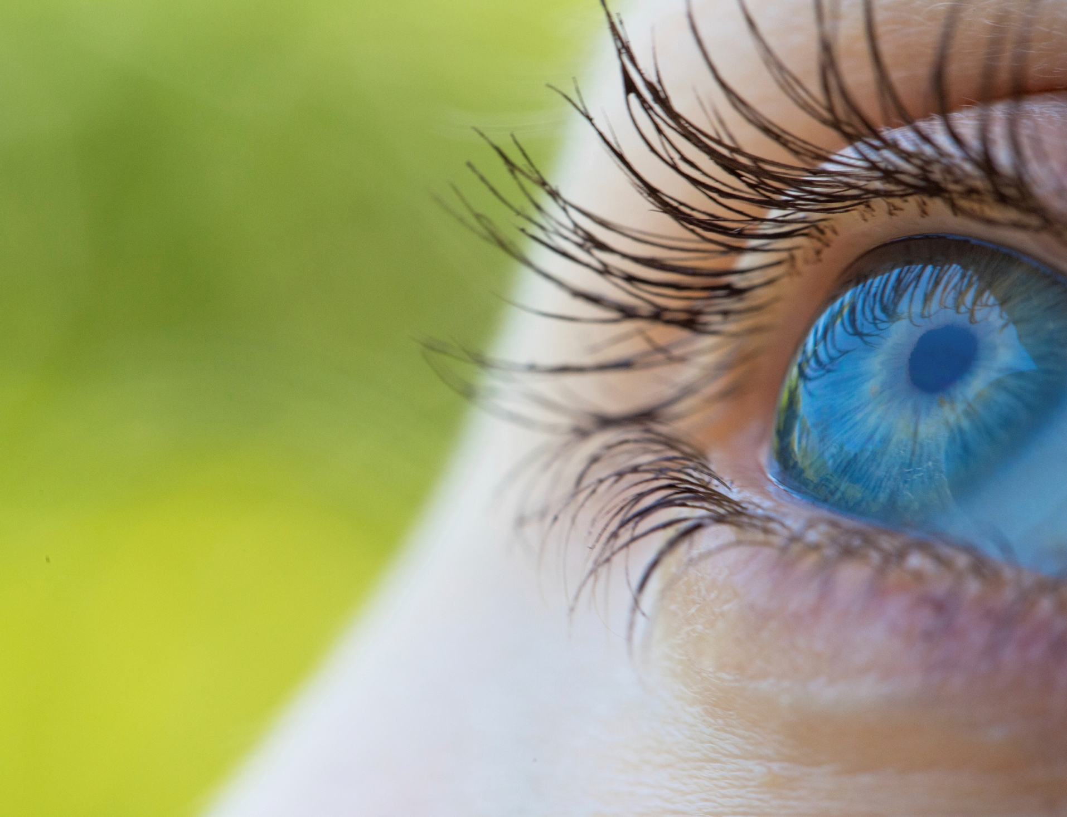
Daylight
Maintains
Circadian rhythms
Hormone and neurotransmtter
production
Mood
Immune system health
Disrupts
Cancer
Diabetes
Low mood
Notes:
Our body’s response to daylight is another important clue as to how we can harness the power of biophilia.
Do you know anyone who is affected by Seasonal Affective Disorder (SAD)?
Daylight affects both our eye functions and our inherent circadian rhythms, the daily cycle of hormonal activity observed in living organisms.
Exposure to natural light balances our hormonal levels of serotonin (linked to our mood) and inhibits the production of melatonin (used to regulate sleep).
When there is an imbalance of serotonin and melatonin in our bodies, our sleep-wake pattern is disturbed, which in turn inhibits the functioning of our neurological and immune system functions.
Light therapy works by exposing the retina to specific wavelengths of light to treat imbalances of circadian rhythm.
Sunlight on a clear day is 500 to 1,000 times greater than artificial lighting (Boyce, 2010). This is an important consideration while designing indoor environments to incorporate more natural light.
Inefficient access to natural daylight and excessive exposure to artificial light can lead to disruption of hormone regulation and circadian rhythms, which in turn can increase the risk of developing cancer, diabetes, low mood and depression.

Slide 17
Fractal Patterns
Increase attention, reduce stress and promote relaxation
Notes:
One of the many components of biophilia’s influence is the connection that humans have with certain fractal patterns that appear commonly in the natural world.
A fractal is a kind of pattern that we observe often in nature and in art, whenever you observe a series of patterns repeating over and over again, at many different scales, and where any small part resembles the whole, that's a fractal.
Fractal patterns found in nature can positively affect human neural activity and parasympathetic system mechanisms. In a case study, when subjects were shown images of fractal patterns in nature or townscapes of the built environment, they were more relaxed when exposed to natural landscapes.
One study concluded that in environments with many stimuli and patterns, the patterns that are most likely to hold our attention and induce a relaxed response are fractal patterns commonly found in nature (Hagerhall, 2008).
The human brain has evolved to process shapes and forms found in nature and does so with minimal effort. This reduces energy required to process imagery and allows for restoration to take place. This is known as perceptual fluency.

Slide 18
Brain Break!
Your idea of a healthy workplace
Notes:
Before we move into the next segment, I’d like to break up the presentation and get your involvement in our experience here today.
There are index cards and pencils on your chairs and if you don’t have them please flag me and we’ll bring you one. I’d like you to take a moment to close your eyes and visualize your personal vision of a healthy workplace. To help you visualize it is probably better to close your eyes so that your eyeball eyes don’t distract your mental eyes. So you are in your ideal workplace...What happens there?. ... What does it look like?... It could be anything from clean bathrooms to a respectful boss and responsible co-workers.
Take a few minutes to think about this...and write your thoughts down on the index card. Then I’d like you to pair up with your neighbor and take turns telling each other what you’ve got down on your card.

Slide 19
The Design Stuff

Slide 20
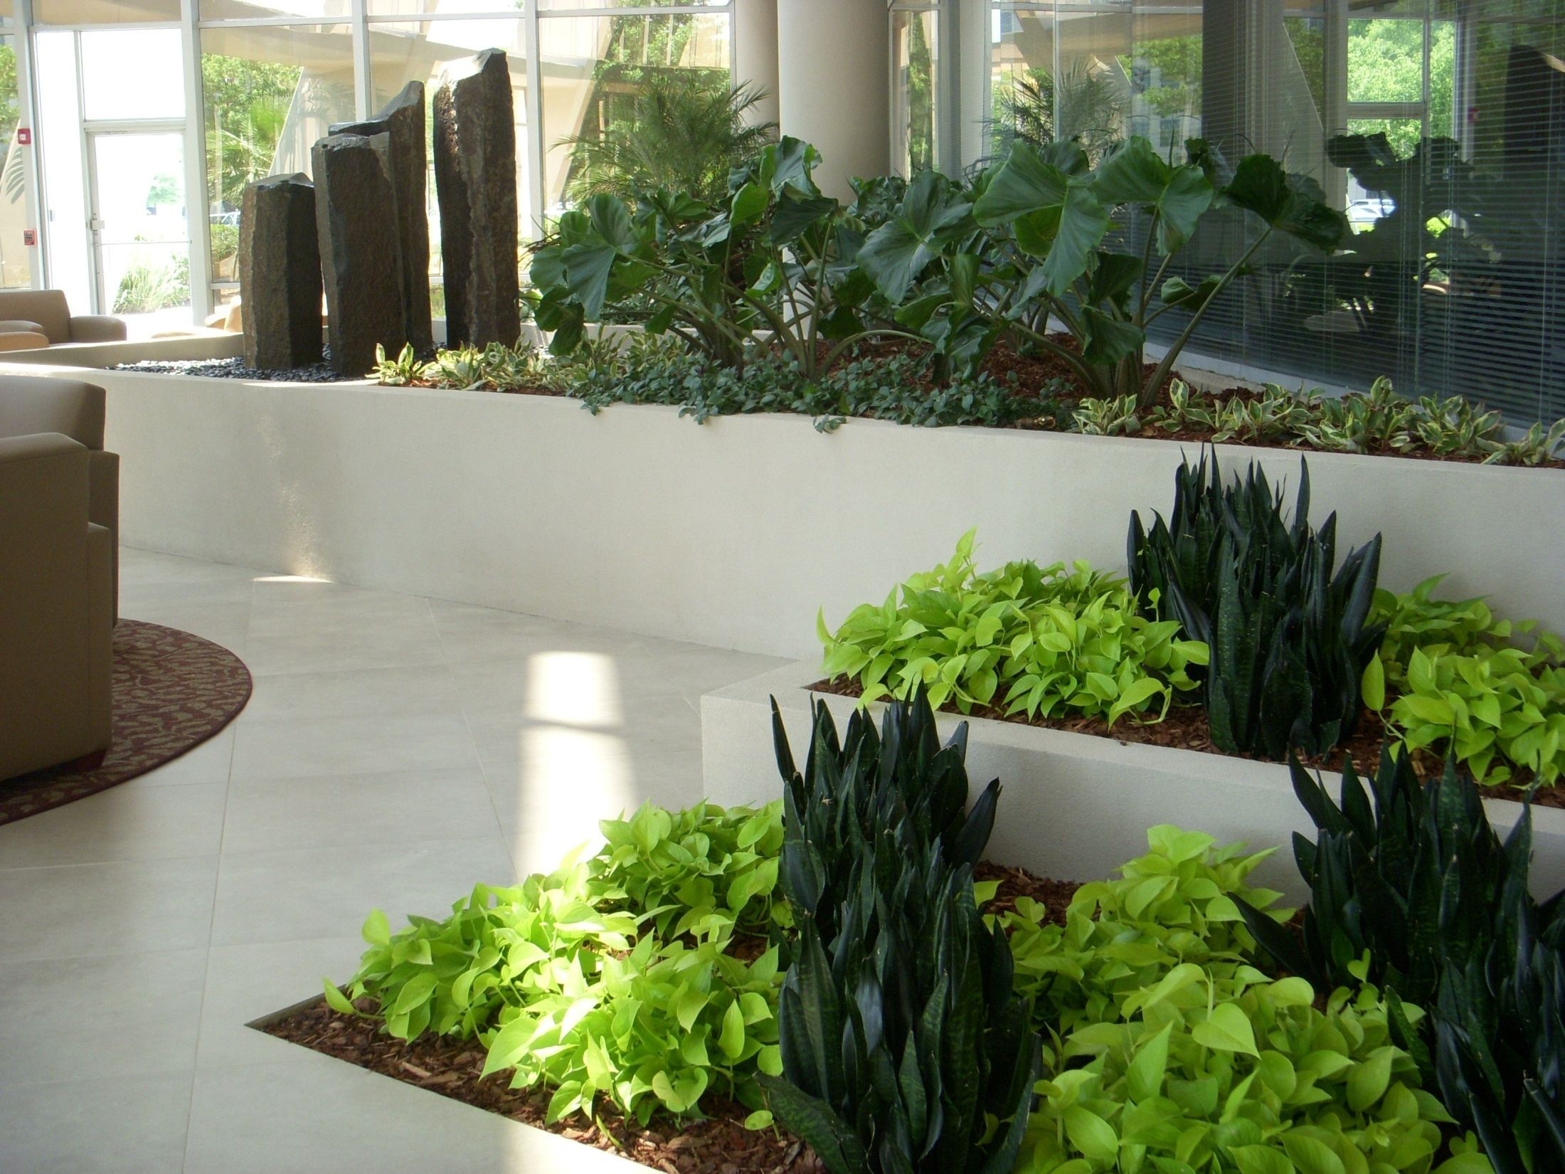
Biophilic Design
Restores natural stimuli to the built environment.
Enhances physiological, cognitive and psychological functions.
Photo: Mike Lewis, Foliage Design Systems, Orlando, FL
Notes:
Biophilic design aims to restore natural stimuli in the built environment so that our physiological, cognitive and psychological connections to the natural world are maintained, restored, and enhanced.
This design ethic is based on research evidence gathered over the last 50 years.
Photo: Mike Lewis, Foliage Design Systems, Orlando, FL

Slide 21
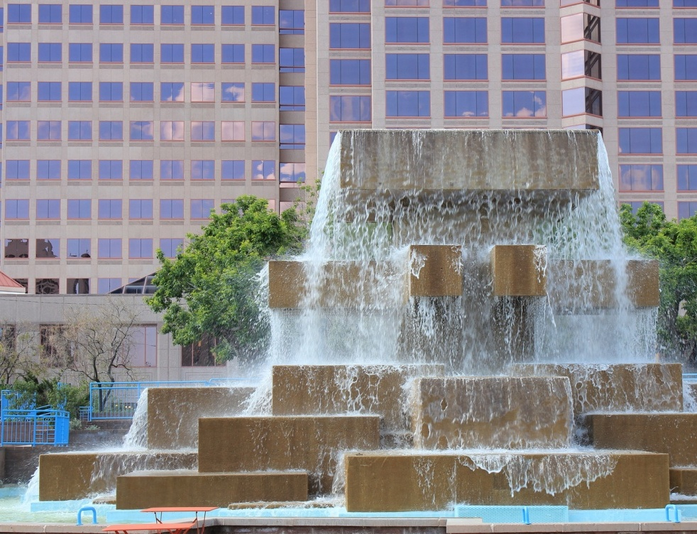
Categorizing Biophilic Design
Nature in the Space
Natural Analogues
Nature of the Space
Notes:
Three pillar concepts serve as the tenets of biophilic design.
I like to think of it in this way. Within the biophilic design toolbox there are three tools.
The tools are Nature in the Space, Natural Analogues, and Nature of the Space.
A design solution may use one, or all, of these tools in creating or retrofitting a space that connects its inhabitants with nature.

Slide 22
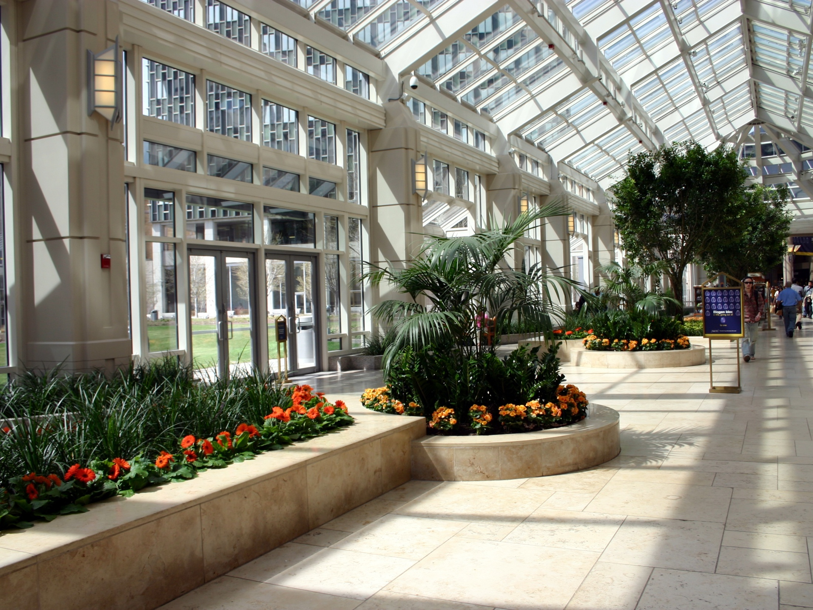
Nature in the Space
Incorporation of plants, water and animals into the build environment.
Produces the strongest biophilic reactions
Photo: Janice Goodman, Cityscapes, Boston.
Notes:
Nature in the Space
Nature in the Space refers to the incorporation of plants, water and animals into the built environment. Examples include potted plants, water features, aquariums, and courtyard gardens, as well as views to nature from the inside of the building. Of the three tools, these direct connections to nature—especially dynamic nature that incorporates movement— produce the strongest biophilic reactions.
The very strongest responses were to Nature in the Space designs that included visual and other sensory diversity, plants at different levels and distances, dynamic movement like those expressed in breezes and water, and sound and aromatic scents.
Photo: Janice Goodman, Cityscapes, Boston.

Slide 23
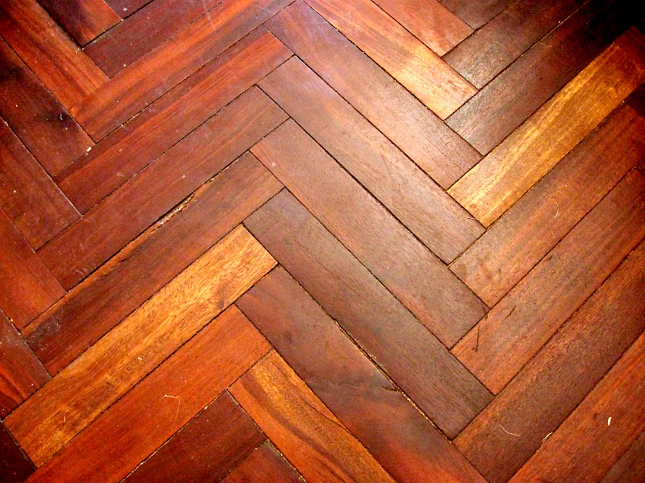
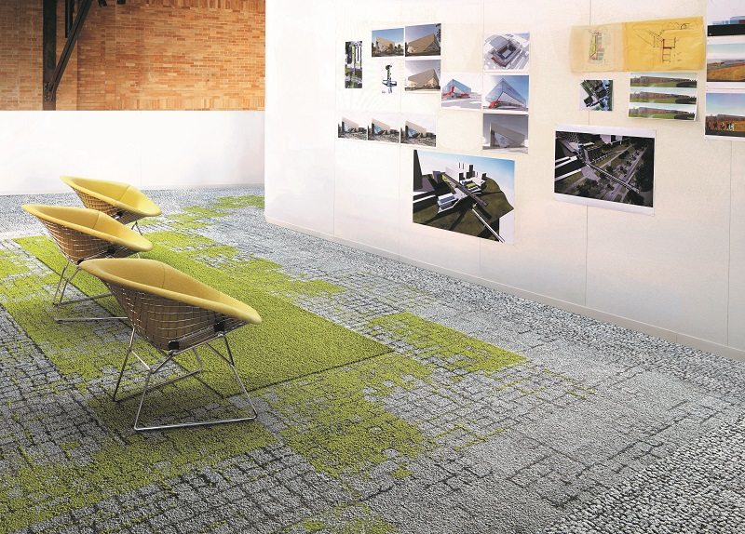
Natural Analogues
Organic, non-living and indirect evocations of nature.
One degree of separation away from true nature.
Produce measureable but less benefits compared to designs with nature in the space.
Notes:
Natural Analogues
The second tool in the biophilic designer’s tool box are natural analogues.
Natural analogues provide an indirect connection with nature and are useful in projects where living natural stimuli are not feasible.
What are they? They are objects, colors, shapes, patterns and sequences, like fractal patterns, which are found in nature. They appear in artwork, furniture, textiles, decor and ornamentation.
The well-being benefits of exposure to natural analogues are measurable and effective although less effective than exposure to the first tool, nature in the space.

Slide 24
Nature of the Space
We respond most positively to savannah-like settings with moderate to high depth and openness.
Notes:
The 3rd tool is Nature of the Space.
Nature of the Space refers to the way humans respond psychologically and physiologically to different spatial configurations.
As mankind developed in the savannahs of Africa, our species’ existence among low-growing grasses, clusters of shade trees, and broad vistas have yielded a modern-day affinity for similar landscapes in indoor and outdoor environments (Kellert et al., 2008).
In fact, more specifically, we are hard-wired to prefer open spaces that are savannah-like settings with moderate to high “depth and openness”.
This is good to know – that our brains are wired this way. When does it mean when applied to an indoor environment?

Slide 25
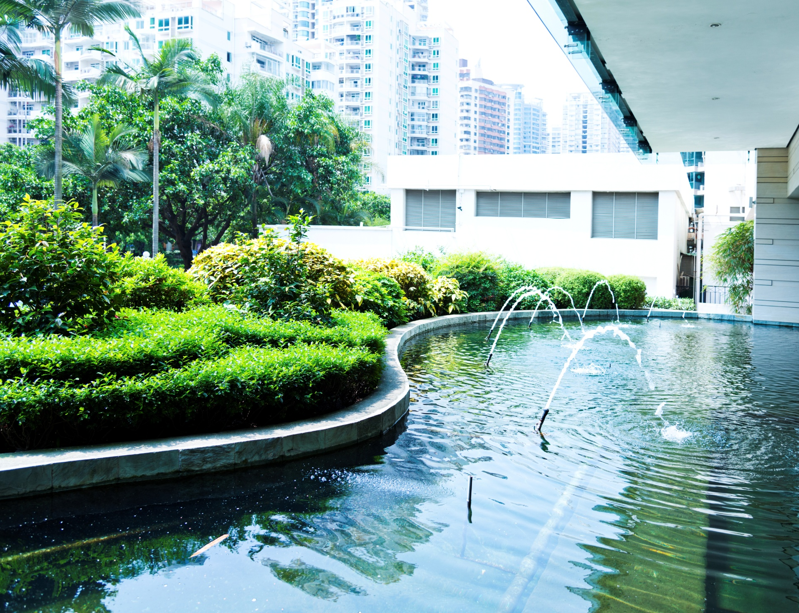
“Nature in the Space” Design
DESIGN ELEMENTS ARE
Dynamic movement
Natural lighting
Water features
Static nature: plants and artwork portraying nature
CASE STUDIES CONCLUSIONS
Better focus
Increased mental stamina
Higher productivity
Reduced absenteeism
Notes:
So of these 3 tools, clearly for us as plant people, the first tool “Nature in the Space” is the tool we are using most frequently. And this tool is a little like a Leatherman; we have plants, we have lighting, we have water features and dynamic movement.
What is dynamic movement? It is a little like vitamin DM. It makes all of the other biophilic design elements more powerful.
What does dynamic movement look, feel and sound like? Moving water, swaying branches and grasses, birdsong, crickets and natural fragrances and aromas.
With research done in an office setting, the most positive physiological responses were recorded in environments where dynamic movement was a design element.
Researchers measured better focus, mental stamina, and productivity— desirable traits that all office managers and employers seek (Kahn, 2008). Worker productivity was enhanced and absenteeism was reduced by up to 15%.

Slide 26
The Economic Stuff
research results from Workplaces – Health care – schools - Retail
Notes:
In this section of our presentation we are examining the fiscal implications of plants and nature-based design in four sectors:
Workplaces;
Healthcare;
Schools;
Retail stores.
As the medical and behavioral data began to accumulate, economists got involved and began to establish the economic cost of things like
...absenteeism due to depression
...or the economic gain to a medical facility when a patient requires less pain medication and is able to be released earlier.

Slide 27
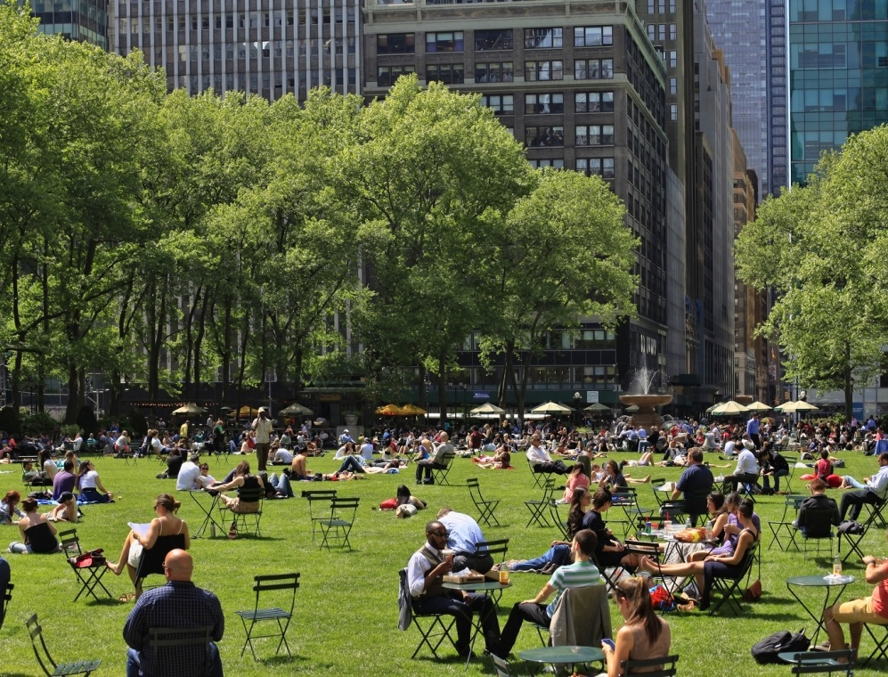
Economic Advantages
Case studies have documented that humans’ affinity
towards nature = potential for financial growth.
Notes:
In the past, the economic benefits of reconnecting people to nature were often overlooked because of the difficulty in economically quantifying the variables associated with the positive outcomes.
Then scientists began to tackle this issue and the research results of neuroscientists and economists were correlated with the result that we are now able to establish the economic cost of things like absenteeism due to depression or the economic gain to a medical facility when a patient requires less pain medication and is able to be released earlier.
Over the last quarter century, case studies have documented that ignoring human affinity for nature diminishes the potential for financial growth.
We can begin to understand the fiscal implications of biophilic design across the economy by examining five of these sectors:
Workplaces;
Healthcare;
Retail stores;
Schools; and
Communities
The numbers presented are powerful evidence that when biophilic design strategies become incorporated into traditional design strategies positive impacts on human health, child development, community safety, and worker satisfaction will follow. And these effects translate directly to increased profits.

Slide 28
The Economic Case
Direct & indirect measures
Absenteeism
Job performance
Staff retention
Healing rates
Learning rates
Retail sales
Violence statistics
Notes:
How do scientists take the evidence for these productivity benefits and translate it into economics?
Current research uses both direct and indirect approaches.
Direct measures of productivity encompass quantifiable reported values. These metrics can be assigned monetary values in their respective settings and directly converted to cost savings for a company or institution.
Indirect measures of productivity include absenteeism, tardiness, hours worked, safety rule violations and other measures that add up quickly in a corporate budget (Miller, 2009).
For this presentation, indicators of productivity will include the following and will be translated into dollars where most applicable:
Illness and absenteeism
Staff retention
Job performance as related to mental stress and/or fatigue
Healing rates
Classroom learning rates
Retail sales
Violence statistics

Slide 29
Why Bother?
HERE’S ONE REASON: The cost of human capital in the workplace is 10x that of other operation expenses.
Notes:
WHY BOTHER?
I’m glad you asked ☺
The cost of human capital in the workplace is 10x that of other operation expenses.
Industries spanning a variety of sectors—from hospitals to corporate offices—spend, on average, 112 times the amount of money on people as they spend in energy costs.
This is precisely where the argument for biophilic design begins to pique the interest of business & building owners, CEOs, school superintendants, and policy-makers.
Small improvements in productivity and reduced absenteeism could boost profits and the bottom line more dramatically than reducing energy costs. In short, productivity drives profit.

Slide 30
Workplace Profit Margins
CASE STUDIES CONCLUSIONS
Over 90% of a company’s operating costs are linked to
human resources.
REQUIREMENTS FOR OPTIMAL FUNCTIONING
Need for change (varied temperature, light, air, etc.).
Ability to act on the environment and see the effect.
Meaningful stimuli.
One’s own territory.
A view to the outside world.
Notes:
2021 Bureau of Labors statistics report total full-time wage and salary workers earn an average of $51,168 per year— a typical small office with fifteen workers alone can cost an employer over $1 million in payroll related expenses (Bureau of Labor Statistics, 2011a, 2011b).
The main causes for deficient productivity include absenteeism, loss of focus, negative mood, and poor health. The built environment, though not always the cause of these stressors, when well-designed, can relieve some of these unwanted symptoms.
In the last decade, American psychologists have aggregated the five strongest requirements for basic functioning that, if neglected, can trigger worker comprehension problems and dissatisfaction at the office (Kellert, 2008). These are:
Need for change (varying temperature, air, light, etc.)
Ability to act on the environment and see the effects
Meaningful stimuli (stagnant atmospheres cause an onset of chronic stress)
One’s own territory to provide safety, an identity, and protection
View to the outside world
These research findings present the an argument for putting plants, in addition to the building entry, in the employee areas. Where are the money spots? Where your staff is.

Slide 31
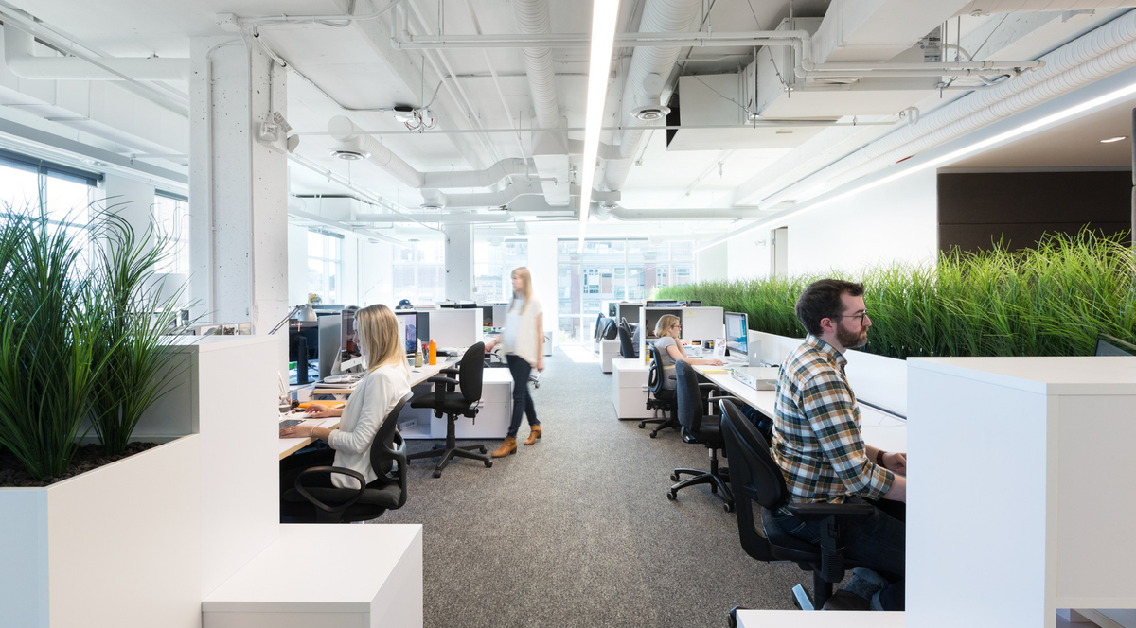
Worker Performance
CASE STUDY CONCLUSIONS – WITH PLANTS AND VIEWS OF NATURE
12% increases in worker productivity.
15% higher levels of well-being.
15% higher levels of creativity.
19% improvements in concentration.
Notes:
Offices in the Netherlands and Great Britain experienced a 15% increase in worker productivity when plants were included in office space
Korpela, K., J. De Bloom, M. Sianoja, T. Pasanen, and U. Kinnunen. 2017. Nature at home and at work: Naturally good? Links between window views, indoor plants, outdoor activities and employee well-being over one year. Land. Urban Plan. 160: 38-47.
Nieuwenhuis, M., C. Knight, T. Postmes, and S.A. Haslam. 2014. The relative benefits of green versus lean office space: three field experiments. Journal of Experimental Psychology - Applied 20 (3): 199–214.
Visible greenery, both indoors and out, reduces stress and increases the ability to concentrate by as much as 19%
Alker, J., M. Malanca, C. Pottage, and R. O’Brien. 2014. Health, wellbeing & productivity in offices. The next chapter for green building. Rep. World Green Building Council. 87 p.
van Duijin, B., J. Klein Hesselink, M. Kester, and Jansen en Hilde SpittersJ. 2011. ‘Planten in de klas’ [plants in the classroom]. Productschap Tuinbouw (Product Board for Horticulture), Rapport Project.

Slide 32
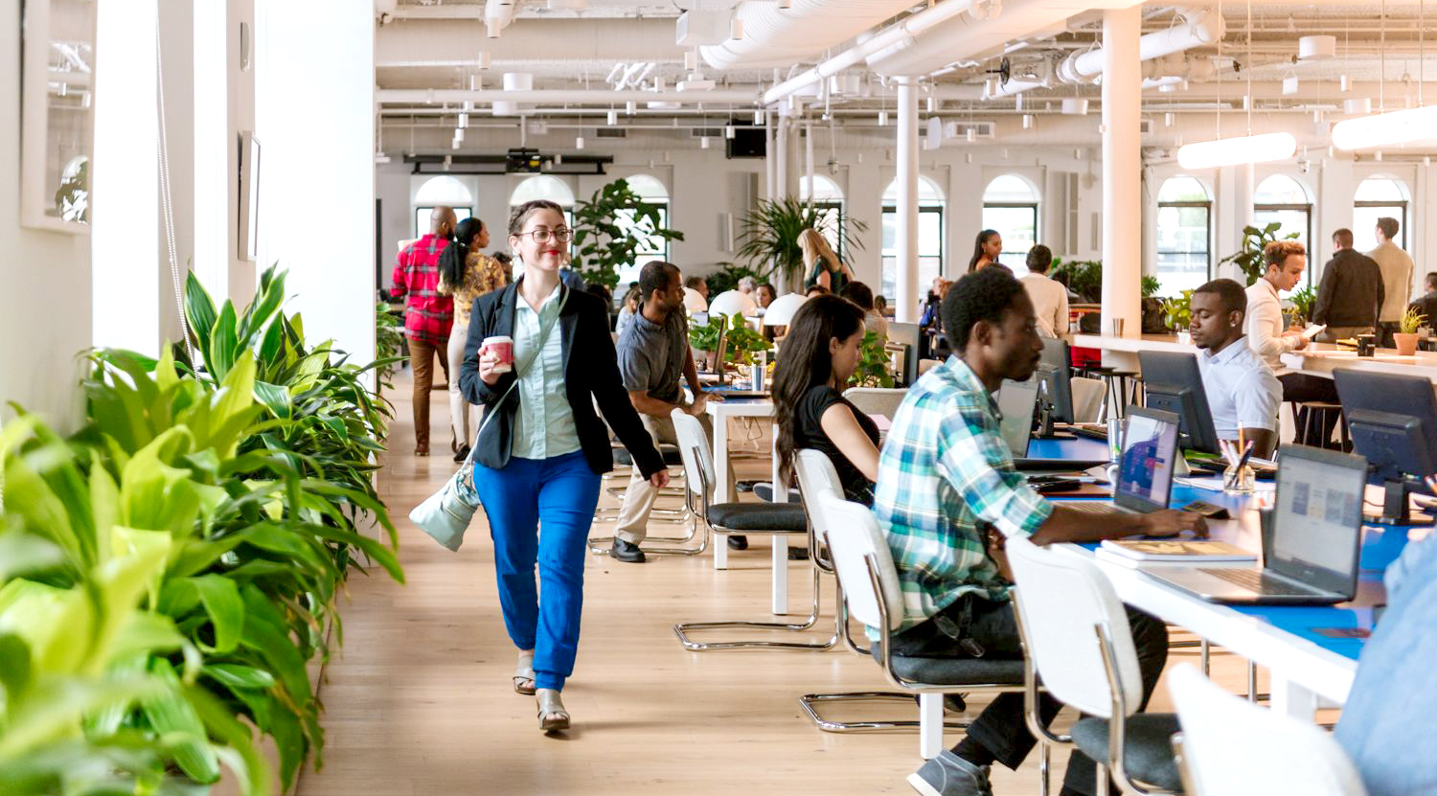
Attracting & Retaining Talent
CASE STUDY CONCLUSIONS – BIOPHILIC DESIGN
33% of workers say workplace design influences their choice of employer selection.
97% of employees say they would like to have more plants at work.
Notes:
One-third of workers say they would be affected by workplace design when choosing a company to work for consequently impacting a company’s ability to attract and retain top talent
Grinde, B., & Patil, G. G. (2009). Biophilia: does visual contact with nature impact on health and wellbeing?. International Journal of Environmental Research and Public Health, 6(9), 2332-2343.
Backhaus, K., & Tikoo, S. (2004). Conceptualizing and researching employer branding. Career Development International, 9(5), 501-517.
Earle, H. A. (2003). Building a workplace of choice: Using the work environment to attract and retain top talent. Journal of Facilities Management, 2(3), 244-257.
Hardy, Q. (2014). The monuments of tech. New York Times.
When asked about plants in the workplace, 97% of employees would like to have more plants
Husti, A.M., I. Ciobanu, R. Cicevan, I. Neacsu, and M. Cantor. 2015. Image of ornamental plants in work enviroments and their effect on employees. Agricultura 95 (3-4): 3–4.

Slide 33
Absenteeism
The problem
Private sector: annual absentee rate per employee 3% - 3.1%
Compounded costs over time
Minor reductions in absenteeism can yield significant annual savings
Notes:
Biophilic design implemented in the workplace can reduce absenteeism, reduce complaints, improve productivity, and help enhance employee retention strategies.
In 2020, the US Department of Labor* reported the following statistics:
For the private and public sectors, an annual absenteeism rate of 3% per employee—or 62 hours lost, per year, per employee. Based on an average annual salary of $51,168, an employer will lose $1,535 per employee per year to employee absences. A company with 20 employees will lose $30,700 in salary costs.
Efforts to reduce absenteeism by even a fraction of a percent through the implementation of biophilic design can yield substantial financial benefits for an organization.
*https://www.bls.gov/cps/cpsaat47.htm

Slide 34
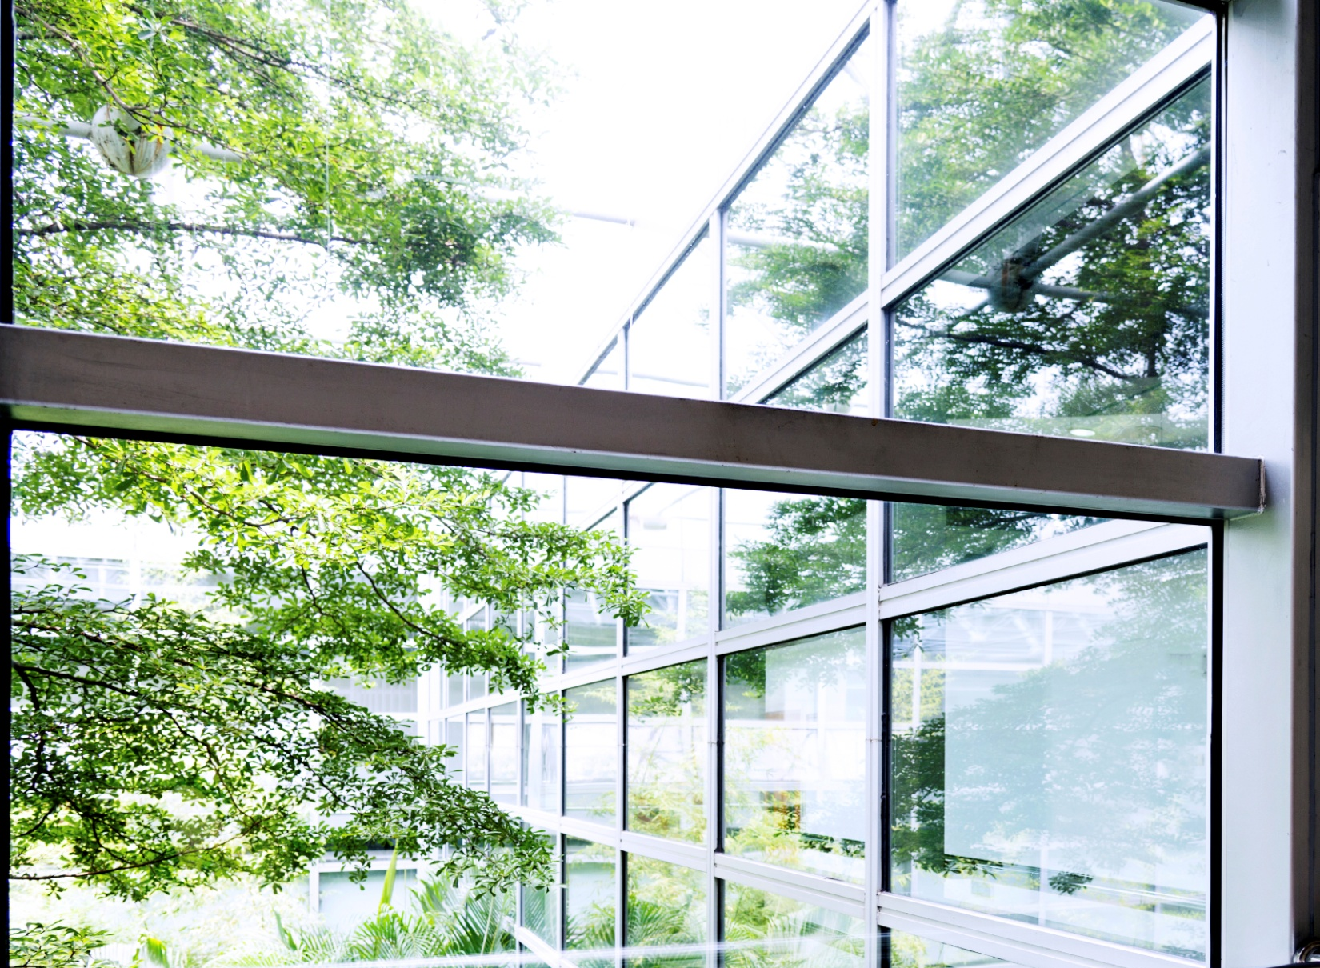
Absenteeism
CASE STUDY CONCLUSIONS - EXTERNAL VIEWS OF NATURE
The quality of a person’s view is the primary predictor of absenteeism.
10% of absences attributed to architecture with no connection to nature.
View quality resulted in an average of 11 hours/year fewer sick days.
Notes:
The potential for building design to cut human resources costs is highlighted by a 2011 study of an administrative office building at the University of Oregon (Elzeyadi, 2011), in which:
30% of the offices overlook trees and a manicured landscape to the north and west
31% overlook a street, building and parking lot to the south and east
39% of the offices are on the interior of the building, offering no outside view at all.
When asked to rate scenes according to their preference, the building’s occupants heavily favored the vegetated views over the urban views, and either view over none at all.
Views significantly affected worker’s levels of happiness, mood, and other behaviors.
The quality of the view from their office significantly affected how they behaved at work.
Employees with external views of nature took an average of 57 hours of sick leave per year, compared with 68 hours per year of sick leave taken by employees with no view.
When placed on a continuum, employees with an urban view ranked between the other two groups, in terms of both preference of view and sick days taken.
Architectural elements explained 10% of the variation in sick leave days taken, with the quality of a person’s view concluded to be the primary predictor of absenteeism.
Employees with better views were likely to spend more time at their desk, while those with urban or no views at all were more likely to spend their lunch breaks seeking spaces with more pleasing views.
These findings, taken together, indicate that people’s access to natural scenery is significantly correlated to their job satisfaction, health, and productivity.

Slide 35
Presenteeism
The Problem: workers sick while at work
Workplace epidemics, injury, depression
Lack of focus, exhaustion, obesity
The Cause:
Attention fatigue
Excessive stimuli or lack of stimuli
The Cost:
$938 per employee annually, private sector
$1,250 per employee annually, public sector
Notes:
Presenteeism describes the phenomenon in which workers clock in sick or are mentally removed from the workplace, causing labor-related financial losses for the company.
Lower productivity results from poor health, exhaustion, headaches, workplace epidemics, and injury. According to recent studies, presenteesim appears to be costing US employers more than absenteesim.
Attention fatigue, a key problem associated with presenteeism, occurs in environments where focus upon a task is difficult, due to lack of stimuli or due to sensory overload from excessive stimuli. This causes stress to slow the heart and breath rates while simultaneously arousing digestion in an attempt to raise energy levels. The combination induces lowered concentration and decreased effectiveness (Maas, 2011).
Presenteeism costs employers, per employee, per year, $938 in the private sector $1,250 in the public sector.
For a company with 100 employees, this equates to over $100,000 lost per year in unproductive time at work.
We get bored with visually boring spaces. Rather than being a distraction, nature serves as a resource that renews our attention, reinstating our cognitive functioning. Providing access to natural day light, outdoor views, and natural ventilation can reduce eyestrain, relieve mental fatigue and return workers’ attention to their work.

Slide 36
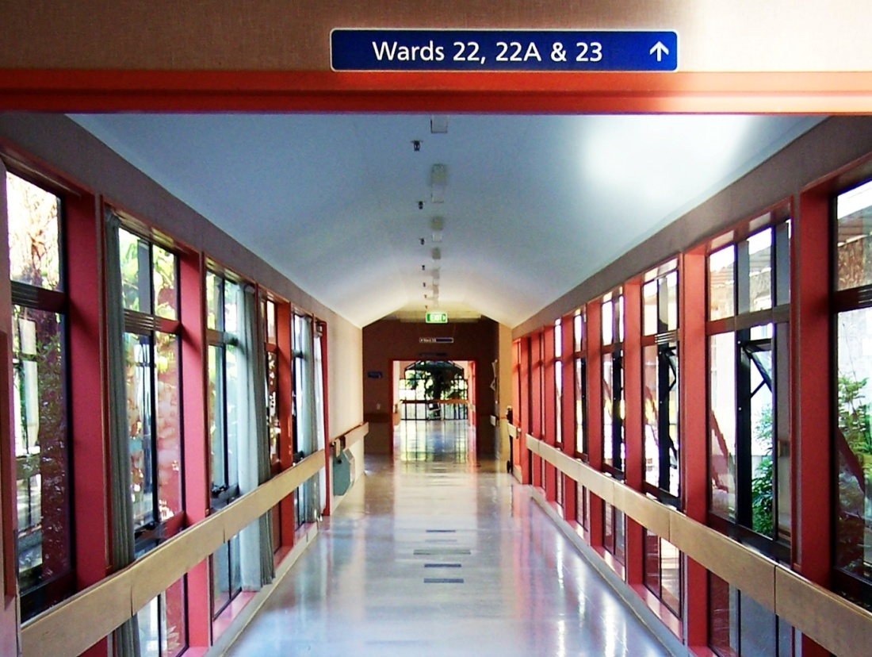
Healthier Patients, Healthier Profits
50+ STUDIES associate biophilic design with
Faster patient recovery rates
Decreased dependency on medication
Reduced staff and family stress
Cost savings compounded over time
DESIGN ELEMENTS ARE
Natural lighting
Views to nature
Notes:
Turning our attention to the health care industry, over fifty studies have been published that associate biophilic elements as the primary influences for faster recovery rates for patients, decreased dependency on medication, reduced staff and family stress, and improved emotional wellness.
In 2020, the United States spent $46 billion on healthcare construction (US Department of Commerce, 2020).
If biophilic design strategies, including access to nature and daylight, are considered during the design and construction phase, the potential exists to cut annual operational costs. These operational savings keep compounding over the service life span of the building.
Studies also show that incorporating even the smallest elements of biophilic design into facilities can reduce the cost of both patient care and staffing, while improving medical outcomes and medical staff mood.
Photo: Thompson Peak Hospital Healing Garden. Scottsdale, Arizona. Gensler.

Slide 37
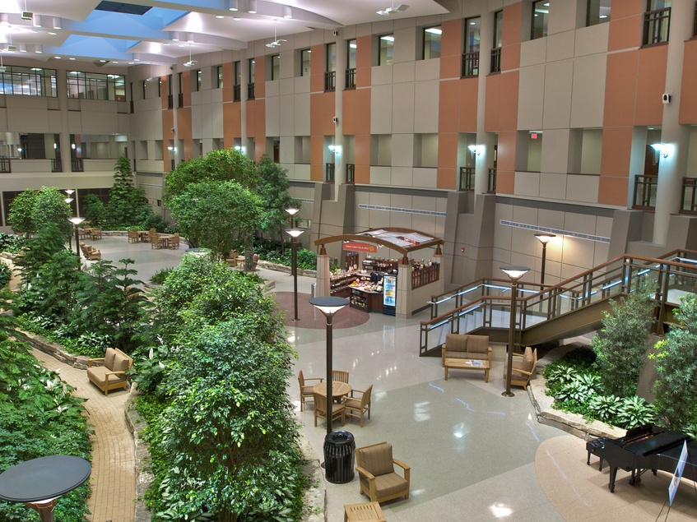
Saving Costs
CASE STUDY CONCLUSIONS - EXTERNAL VIEWS OF NATURE
Accelerated surgery recovery rate by 8.5%, about 1 day.
Reduced need for post-surgery medication.
Average costs per day in hospital (2004) $5,059 applied to study yields reduced cost of patient care by $161,000.
Photo: Henry Ford Hospital, West Bloomfield, MI
Notes:
In 1984, Roger Ulrich pioneered a seminal study to measure the influence of natural and urban scenes on patients recovering from gallbladder surgery. Some patients were provided with views to nature, whereas others looked at brick walls.
With all other variables equal, his findings revealed accelerated recovery rates and reduced stress for the patients who had views of nature.
He found that patients with a view to nature are more likely to experience hospital stays that are 8.5% shorter, with fewer negative observational comments from nurses...we want to avoid those...... and significantly less post-surgical pain medication.
If cost figures from the Agency for Healthcare Research and Quality are applied to the Ulrich study, the cost of patient care could have been reduced by over $11,700 if patients were released just one day sooner.
Photo: Henry Ford Hospital, West Bloomfield, MI

Slide 38
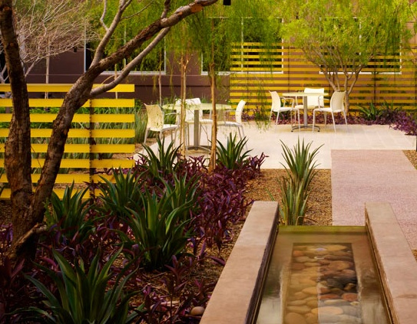
Psychological Needs of Patients, Visitors & Staff
DESIGN ELEMENTS ARE
Natural lighting
Views to nature
Access to nature
Notes:
Addressing the psychological needs of patients, visitors and staff has economic benefits as well.
Stress levels increase <<in patients, visitors and medical staff>> when there is high responsibility and low control. This is a very common dynamic in our personal lives and institutional health care worlds. If you have ever has to await the diagnosis for a symptom that is “not well understood” or had to puzzle through the health insurance maze you have experienced this high consequences/low control phenomena. It is crazy making!
For health care providers, constant stress, in addition to damaging their own wellbeing, diminishes their alertness which can be crucial to the comfort and health of their patients.
The good news is that studies in horticulture therapy directly credit access to nature and daylight with reducing patient and staff stress, and increasing staff satisfaction, along with reducing patient medication use. (Sadler et al., 2008).

Slide 39
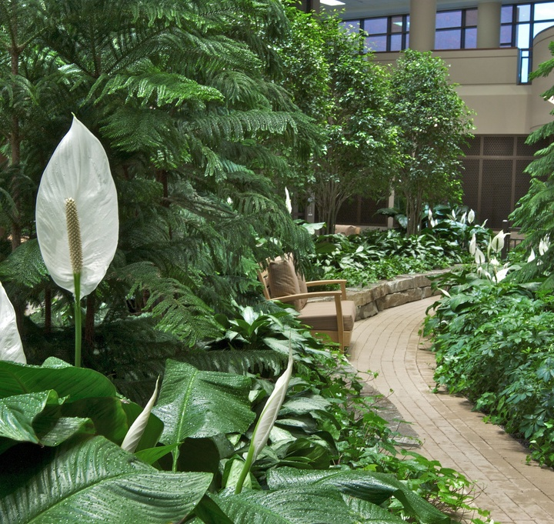
Healing Gardens
CASE STUDY CONCLUSIONS
Increased alertness
Reduced stress
Improved mood
Increased job satisfaction
DESIGN ELEMENTS ARE
Access to nature
Natural lighting
Views to nature
Henry Ford Hospital, West Bloomfield, MI
Notes:
Healing gardens are a biophilic design remedy rapidly being embraced by health care thought leaders like those who built the Henry Ford Hospital in West Bloomfield, MI pictured here.
These indoor and outdoor garden spaces have repeatedly been found to promote good health and act as a place of social connectivity for patients.
Research results include these:
95% of people visiting patients, surveyed across four independent hospitals, reported feeling more relaxed, rejuvenated, and positive. They also reported feeling more able to cope with the ongoing medical situation (Marcus & Barnes, 1995).
Nurses and hospital staff reported feeling less anxiety and depression, and greater job satisfaction. They also reported faster recovery from stress and increased job performance.
Photo: Henry Ford Hospital, West Bloomfield, MI

Slide 40
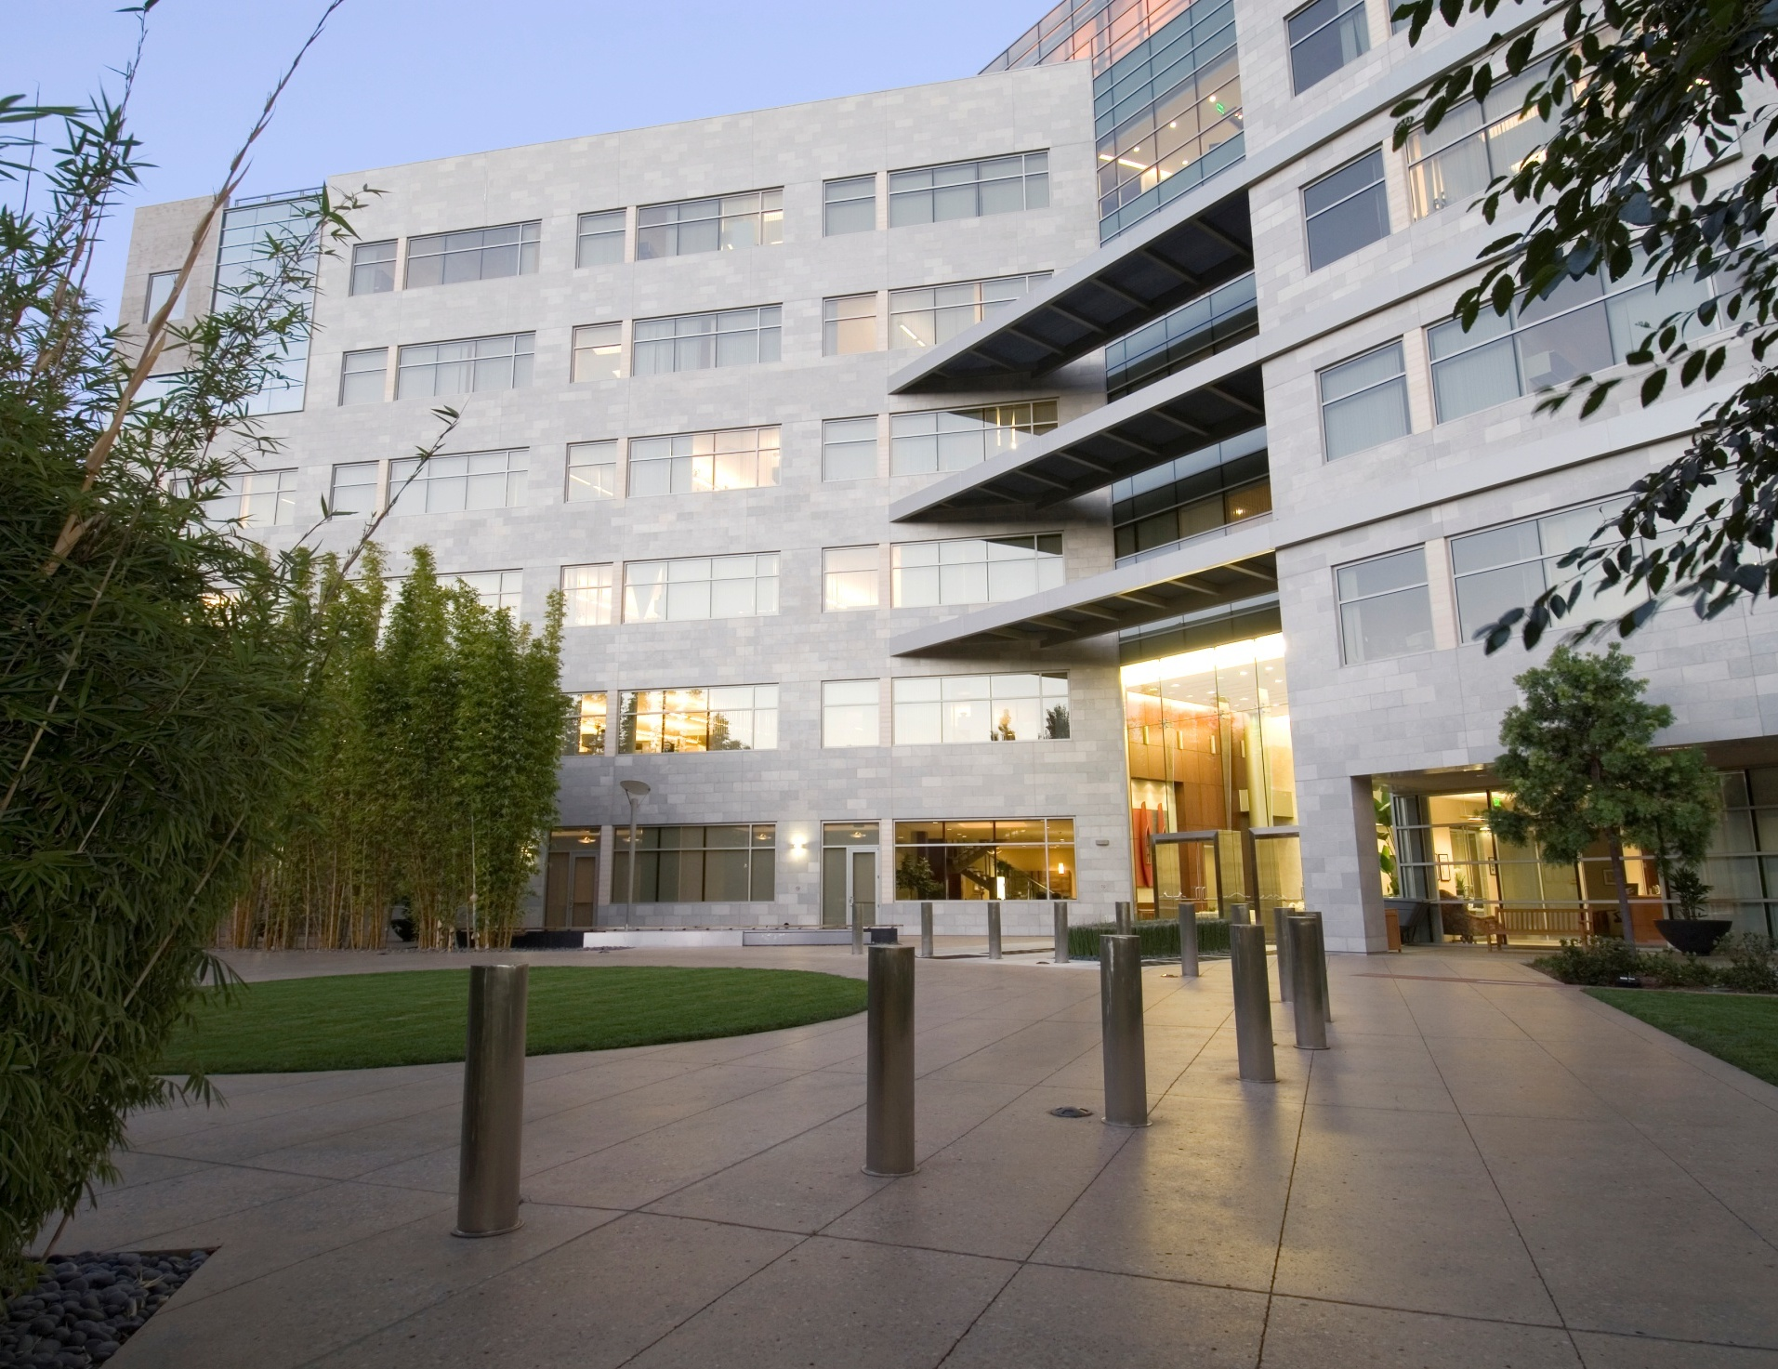
Natural Light
Rooms with daylight
Reduced length of hospital stays by an average of 2.6 days.
Increased recovery rate for those with depression.
Savings related to reduced medication.
Notes:
174 patients being treated for bipolar disorder and depression were the focus of another study (Beauchemin & Hays, 1996). Patients who were treated in rooms with natural daylight were discharged from the facility an average of 2.6 days earlier than the patients being treated in dully lit rooms.
To assign this data economic significance, pharma-economists at the University of Texas estimate that the treatment of each case of bipolar disorder costs a minimum of $11,720 (Begley et al., 1998).
If one applies this cost to the context of the study, and if a fraction of this value was deducted because of reduced treatment time, $296,000 ($3,402 per patient) could have potentially been saved if the other 87 patients in this study also been released earlier as a result of recovering in naturally lit rooms.

Slide 41
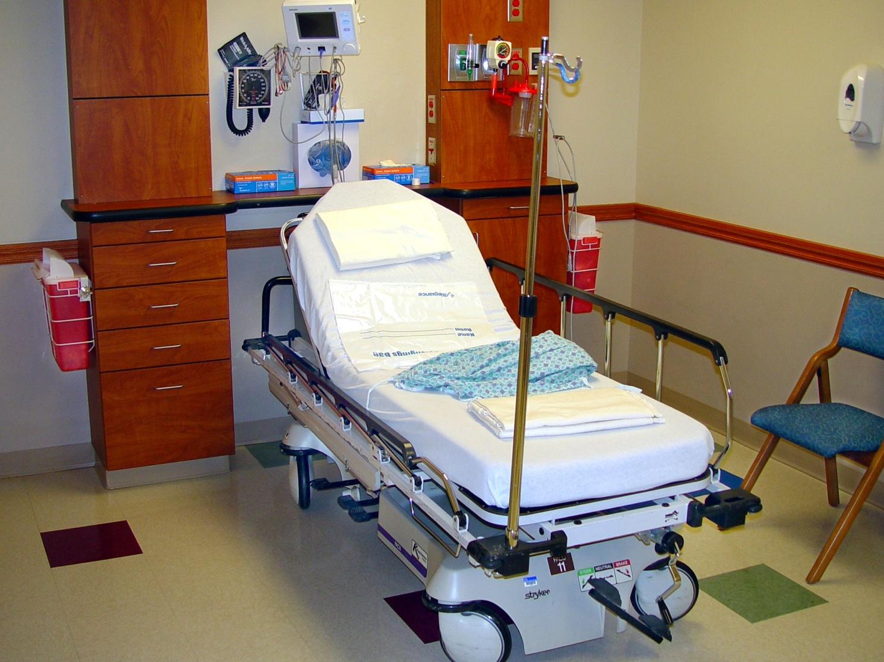
Less Pain, Fewer Drugs, Faster Recovery
CASE STUDY CONCLUSIONS – DAYLIGHT
Higher levels of exposure to daylight
Reduced patient perception of pain
22% less pain medication consumed per hour
21% savings in pain medication costs for length of stay
Notes:
The cost of medication in America has skyrocketed in the last fifty years.
More money per person is spent on healthcare in the United States than in any other country (WHO, 2009).
The United States collectively spent $3.8 trillion in healthcare costs, which equals more than 17% of the nation’s Gross Domestic Product (U.S. Department of Health & Human Services, 2019).
In 2005, a study assessed the significance of sunlight in a hospital room on patients’ recovery. The study measured pain medication – the amount and the costs.
The study determined that patients exposed to greater doses of sunlight perceived less pain, took 22% less pain medications per hour, and accumulated 21% less in pain medication costs for the length of their stay (Walch et al., 2005).

Slide 42
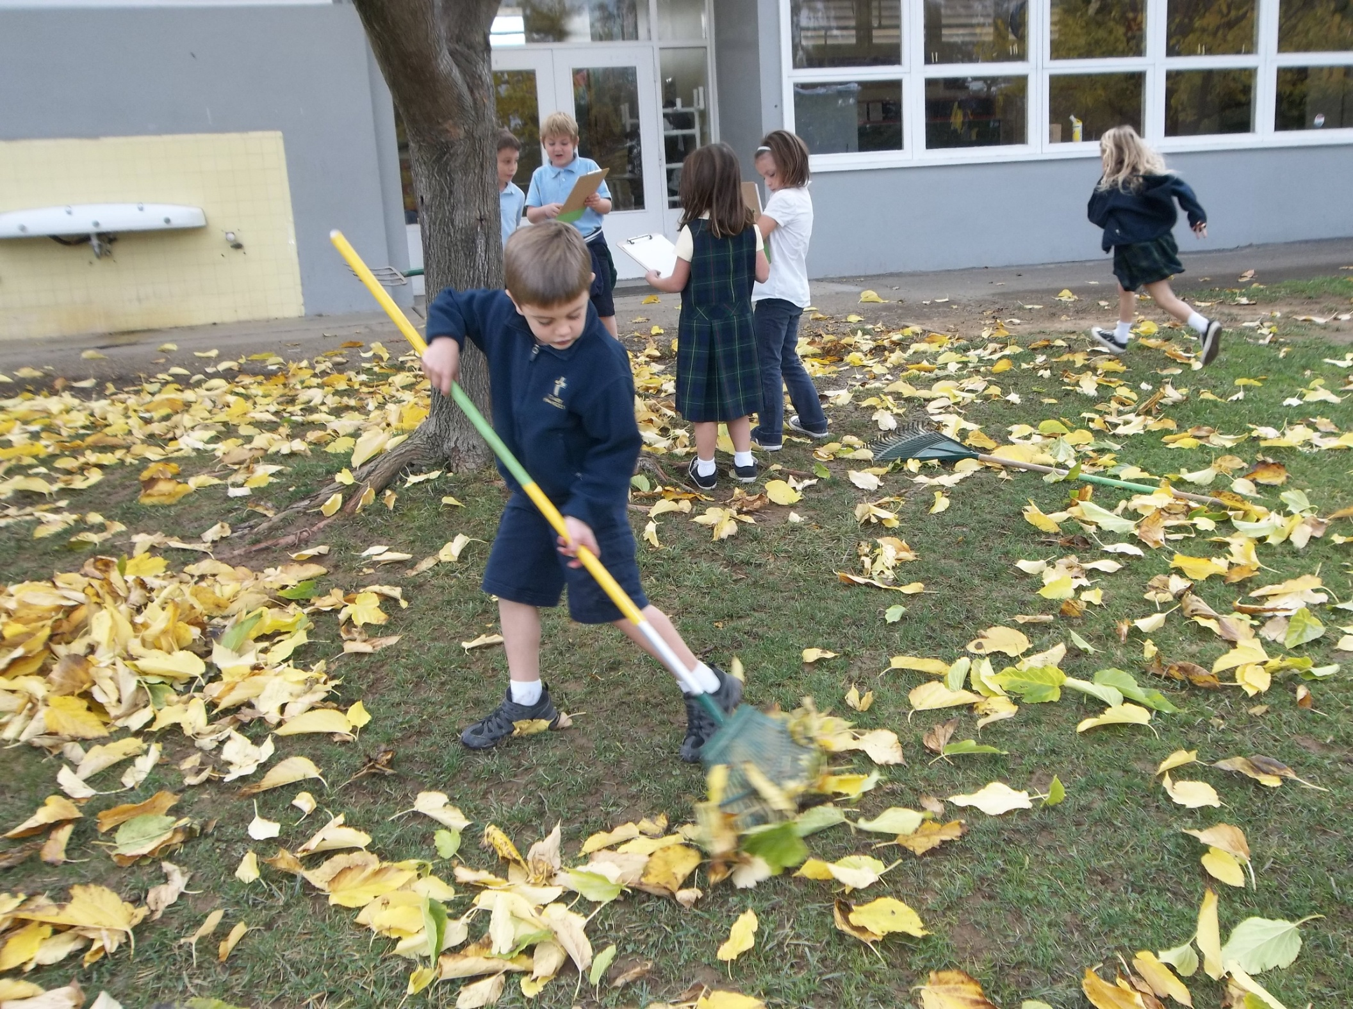
Biophilic Design in Educational Settings
CASE STUDY CONCLUSIONS
Increased test scores
Increased learning rates
Enhanced focus
Improved mood and behavior
Notes:
Moving on to the education sector, the classroom is perhaps the most influential environment outside the home where children will experience rapid brain development and expansion in social skills. It is critical to infuse these learning environments with as many positive attributes as possible.
When children, just like adults, become engaged in nature, their neural mechanisms are allowed to rest and recover.
Attention restoration is critical for children in school. Without it, students will increasingly respond to distracting stimuli, experience greater loss of focus, and have difficulty managing daily tasks (Wells & Evans, 2003).
Current research shows that biophilic design implemented in the classroom can increase test scores, learning rates and improve mood.
And that students who play in school yards that provide access to nature have been shown to experience improved mental restoration, and demonstrate better behavior, with enhanced focus.

Slide 43
Performance & Attendance
Daylit classrooms
Increased attendance
Avoidance of lost taxes through absence
Access to nature
Improved student retention
Educated population
Increased tax income
CASE STUDIES CONCLUSIONS – DAYLIGHT &
ACCESS TO NATURE
Increased attendance by 3+ days/year
Increased test scores 5-14%
Increased progress through curricula by 20-26%
Improved student retention
Notes:
In studying daylight in classrooms, attendance was found to increase by 3.2 to 3.8 days/student/year when compared with attendance at non-daylit schools.
The research from multiple studies shows good day lighting “improves tests scores, reduces off-task behavior, and plays a significant role in the achievement of students” (Kats, 2006).
It was found to increase test scores between 5-14% and increase learning rates by a 20-26%. (Heschong, 1999).
The greatest improvements were seen in classrooms with both daylight and windows with direct views of nature.

Slide 44
Economic Impact for Education
Improved experience of school through nature can improve attendance and student retention
Reduced stress
Improved attention
Improved mood
Better outcomes for investment in education
Avoided lost taxes through absence
Increased personal wealth
$ 272,000 lifetime cost to society for a single dropout
Notes:
Annually the United States spends over $739 trillion dollars on elementary and secondary (K-12) education with the cost of averaging $14,439 per student (US Census Bureau, 2020). Can the effectiveness of this public investment be increased?
The research results indicates the answer is “yes”. More students in class, more on task, progressing through their studies more quickly, testing higher.
US Census Bureau, 2017—
Median earnings of full-time worker 25 through 34 not completing high school - $26,000
Earnings of workers whose highest education level was high school completion - $32,000
Associate’s degree - $39,000
Bachelor’s or higher degree - $55,000, 2x
Unemployment rate for high school dropouts 6% higher than general population.
A single high school dropout costs the US economy approximately $272,000 over his or her lifetime in terms of
lower tax contributions,
higher reliance on Medicare and Medicaid
Higher rates of criminal activity
Higher reliance on welfare
National Center for Education Statistics, 2017
Current research shows that biophilic design implemented in the classroom can increase test scores, increase learning rates, enhance focus and improve mood. ***

Slide 45
Brain Break!
Your ideal grocery store
Notes:
In preparing for this presentation I read a study and I thought this would be fun to see if our group gets the same results as the researchers.
What I’d like to ask you to do is to take a moment to visualize your ideal grocery store. Close your eyes and visualize it. Then use the index cards if you still have them because they will be a handy way of “reporting the research results”.
After you have had a chance to express your thoughts on the cards I’ll invite a couple of you to share what your thoughts on your ideal grocery store.
And in exchange I’ve got a present for you.

Slide 46
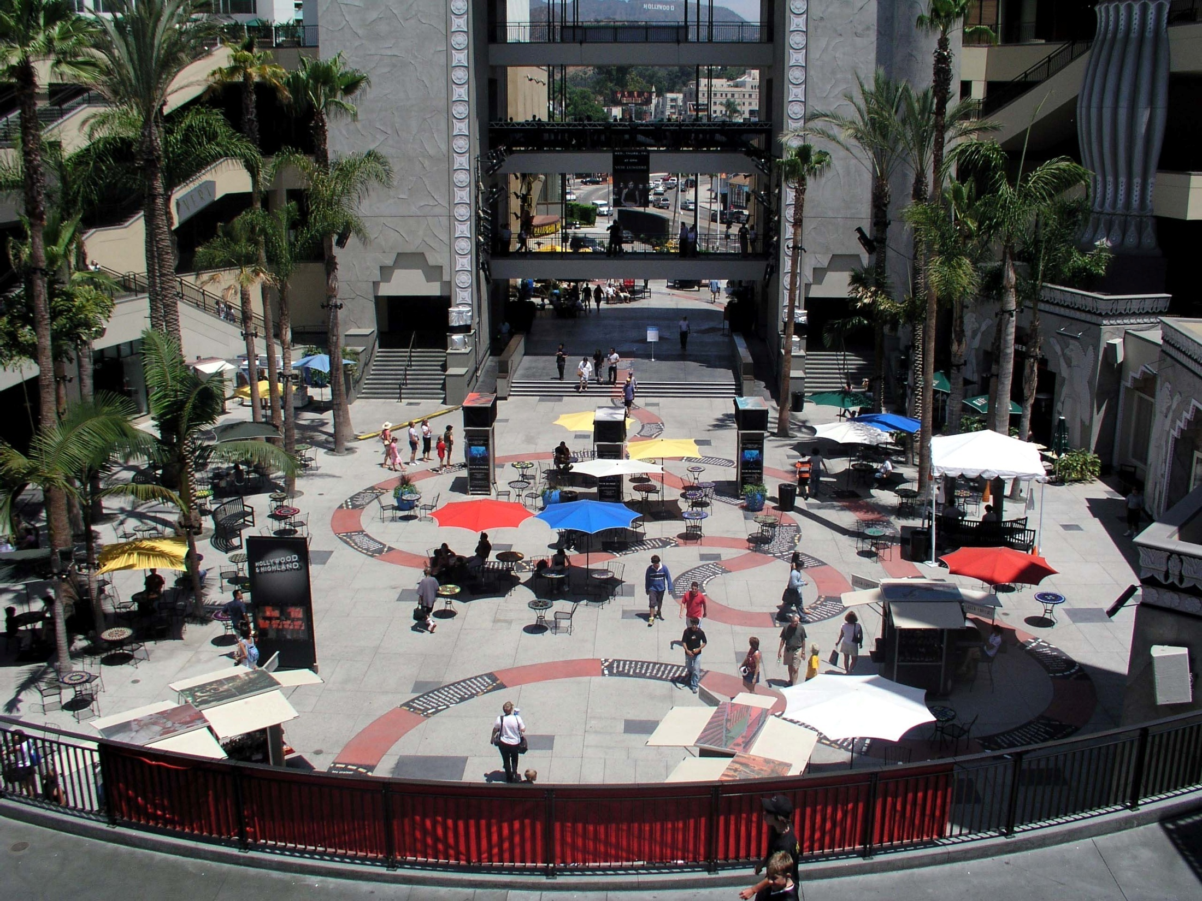
Nature in Retail Spaces
Nature is psychologically soothing and provides the shopper with a more enjoyable consumer experience.
Potential growth for the $3.9 trillion US retail market.
Notes:
These days people spend a lot of time in retail areas; these are the places we buy our groceries there, catch up with friends, spend our lunch breaks, and shop for ourselves and others.
The average American spends $12,990 in retail settings per year. Biophilic design strategies provide a way for this $3.9 trillion market to increase sales while providing a more enjoyable consumer experience.
A 2003 study revealed that 10% of shoppers enter a store in a negative mood. (Negative affect: The dark side of retailing.) Sometimes shopping activity is constrained by time or budget, which can make the shopping experience stressful and irritating, and leads to avoidance behavior. (The effects of urban retail greenery on consumer experience: Reviewing evidence from a restorative perspective.)
Retailers in malls and outdoor markets across the world, from suburban America, to central Istanbul, to Singapore, are using biophilic design to increase their customer’s comfort levels and sales.
Greenery has a mitigating effect on stress, negative mood, and discomfort. The psychologically soothing and calming effect of nature has been used to draw shoppers into stores and boost sales, significantly improving profit margins for stores and property owners with biophilic elements compared to those without.

Slide 47
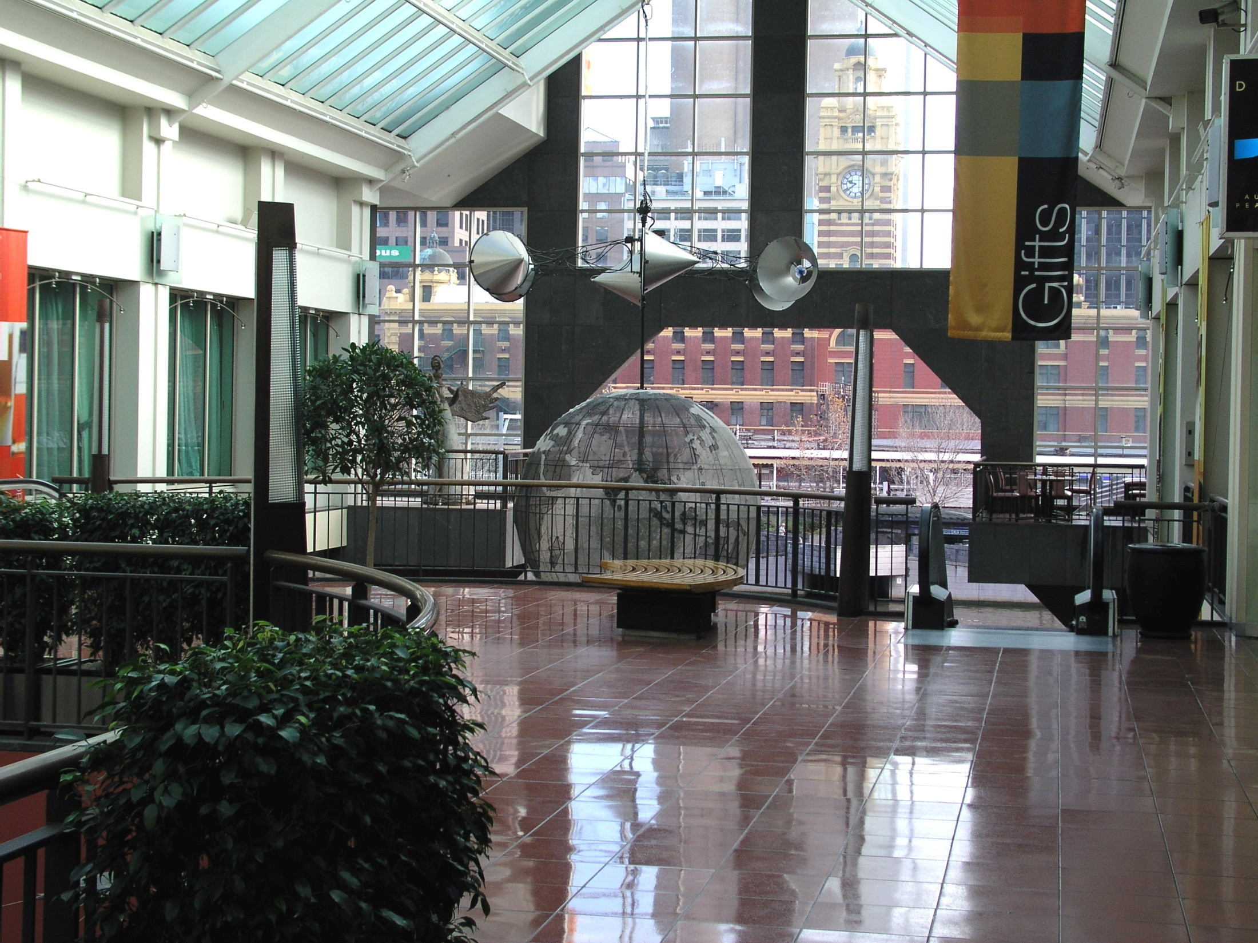
Biophilic Store Design
CASE STUDY CONCLUSIONS
15-40% increase in gross sales after sky lights are installed.
DESIGN ELEMENTS - SAVANNAH SPATIAL CONFIGURATION
Clustered trees
Semi-open spaces
Refuge from the sun
Water features
Multiple view corridors
Notes:
The research evidence demonstrates that consumers are likely to buy more merchandise in stores with natural vegetation. It is not a coincidence that store and mall layouts intentionally guide shoppers through a maze of products surrounded by strategically placed plants, trees, and skylights. These small yet powerful influences on consumers lead retail stakeholders to enjoy greater profits. (Joye, 2010).
Access to nature may take the form of integrating clustered trees, semi-open spaces, refuge from the sun, water features, multiple-view corridors, and high levels of visual access. This later, visual access from an elevated level, replicates the spatial configuration of the African savannah that I mentioned in Nature of the Space.
Think about the places you like to shop and I’ll bet there are some biophilic design elements there.
Daylight in the retail setting also offers an easy method for stores to dramatically boost their sales—simply by ensuring that natural light floods the retail floor space.
Non-skylit stores experienced a 15%-40% increase in gross sales after the installation of skylights.

Slide 48
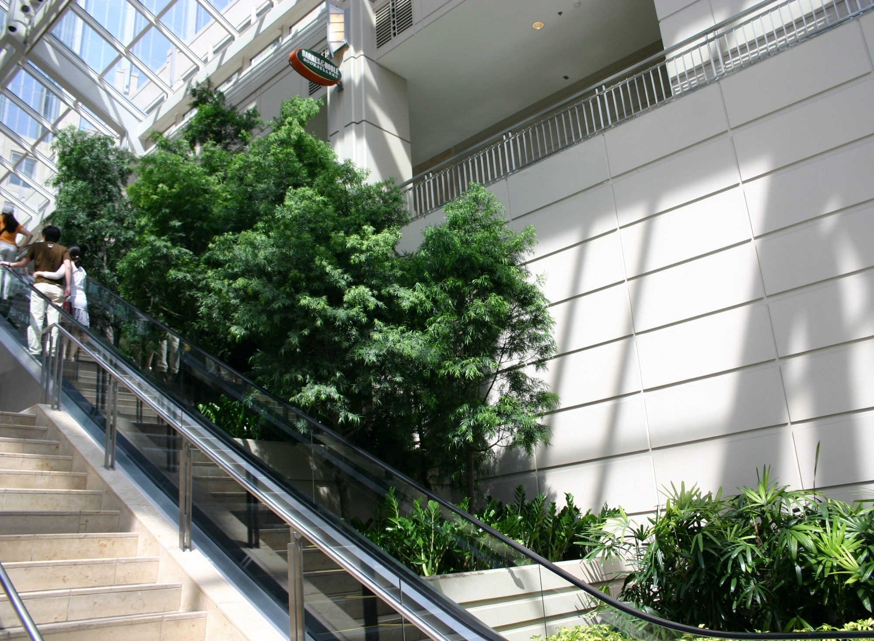
Increased Value for Goods
CASE STUDY CONCLUSIONS – ACCESS TO NATURE
Customers willing to pay 15-25% more for a product in retail environments with access to nature.
Photo: Janice Goodman, Cityscapes, Boston.
Notes:
In another study, when shown images of retail settings with greenery, respondents indicated that an acceptable price to pay was:
20% more for an item in a convenient shopping venue (i.e. sandwich for lunch);
25% more for general shopping item (i.e., a new jacket or watch); and
15% more for specialty shopping (i.e., a gift for a family member) (Wolf, 2005).
Photo: Janice Goodman, Cityscapes, Boston.

Slide 49
Retail Profits
CASE STUDY CONCLUSIONS
Increased retail sales
Increased rental rates for building owners
Enhanced staff performance
Photo: Apple store at Union Square, SF, by Foster + Partners, Nigel Young
Notes:
In a 2003 study when customers were asked to imagine their ideal food store, several groups spent more time describing their preferred shopping environment rather than the items they need to see in stock so that they could buy them.
They wanted to shop in “a spacious, bright, green, and nice atmosphere, with appropriate music in the background”. Subsequent studies found that shoppers were more inclined to enter a shopping mall when it contained vegetation and that “the presence of greenery led to higher exploration rates within the space.”
A third study found that “places with greenery are often regarded as destination places to be visited and enjoyed. As a result shoppers are prepared to travel farther, pay more for parking, pay more for the goods they buy, and stay longer in these locations than those without greenery.”
Add to this the information contained in a Natural Resources Defense Council report that “major urban quality upgrades can add 22% on average to rental rates for retail buildings.
Plus those working in the retail environments (customer sales associates, cashiers, hospitality, etc. ) experience the same wellbeing benefits of improved mood, focus and behavior and quicker recovery from stress when they have access to nature.
Photo: Apple Store at Union Square, Foster + Partners by Nigel Young

Slide 50
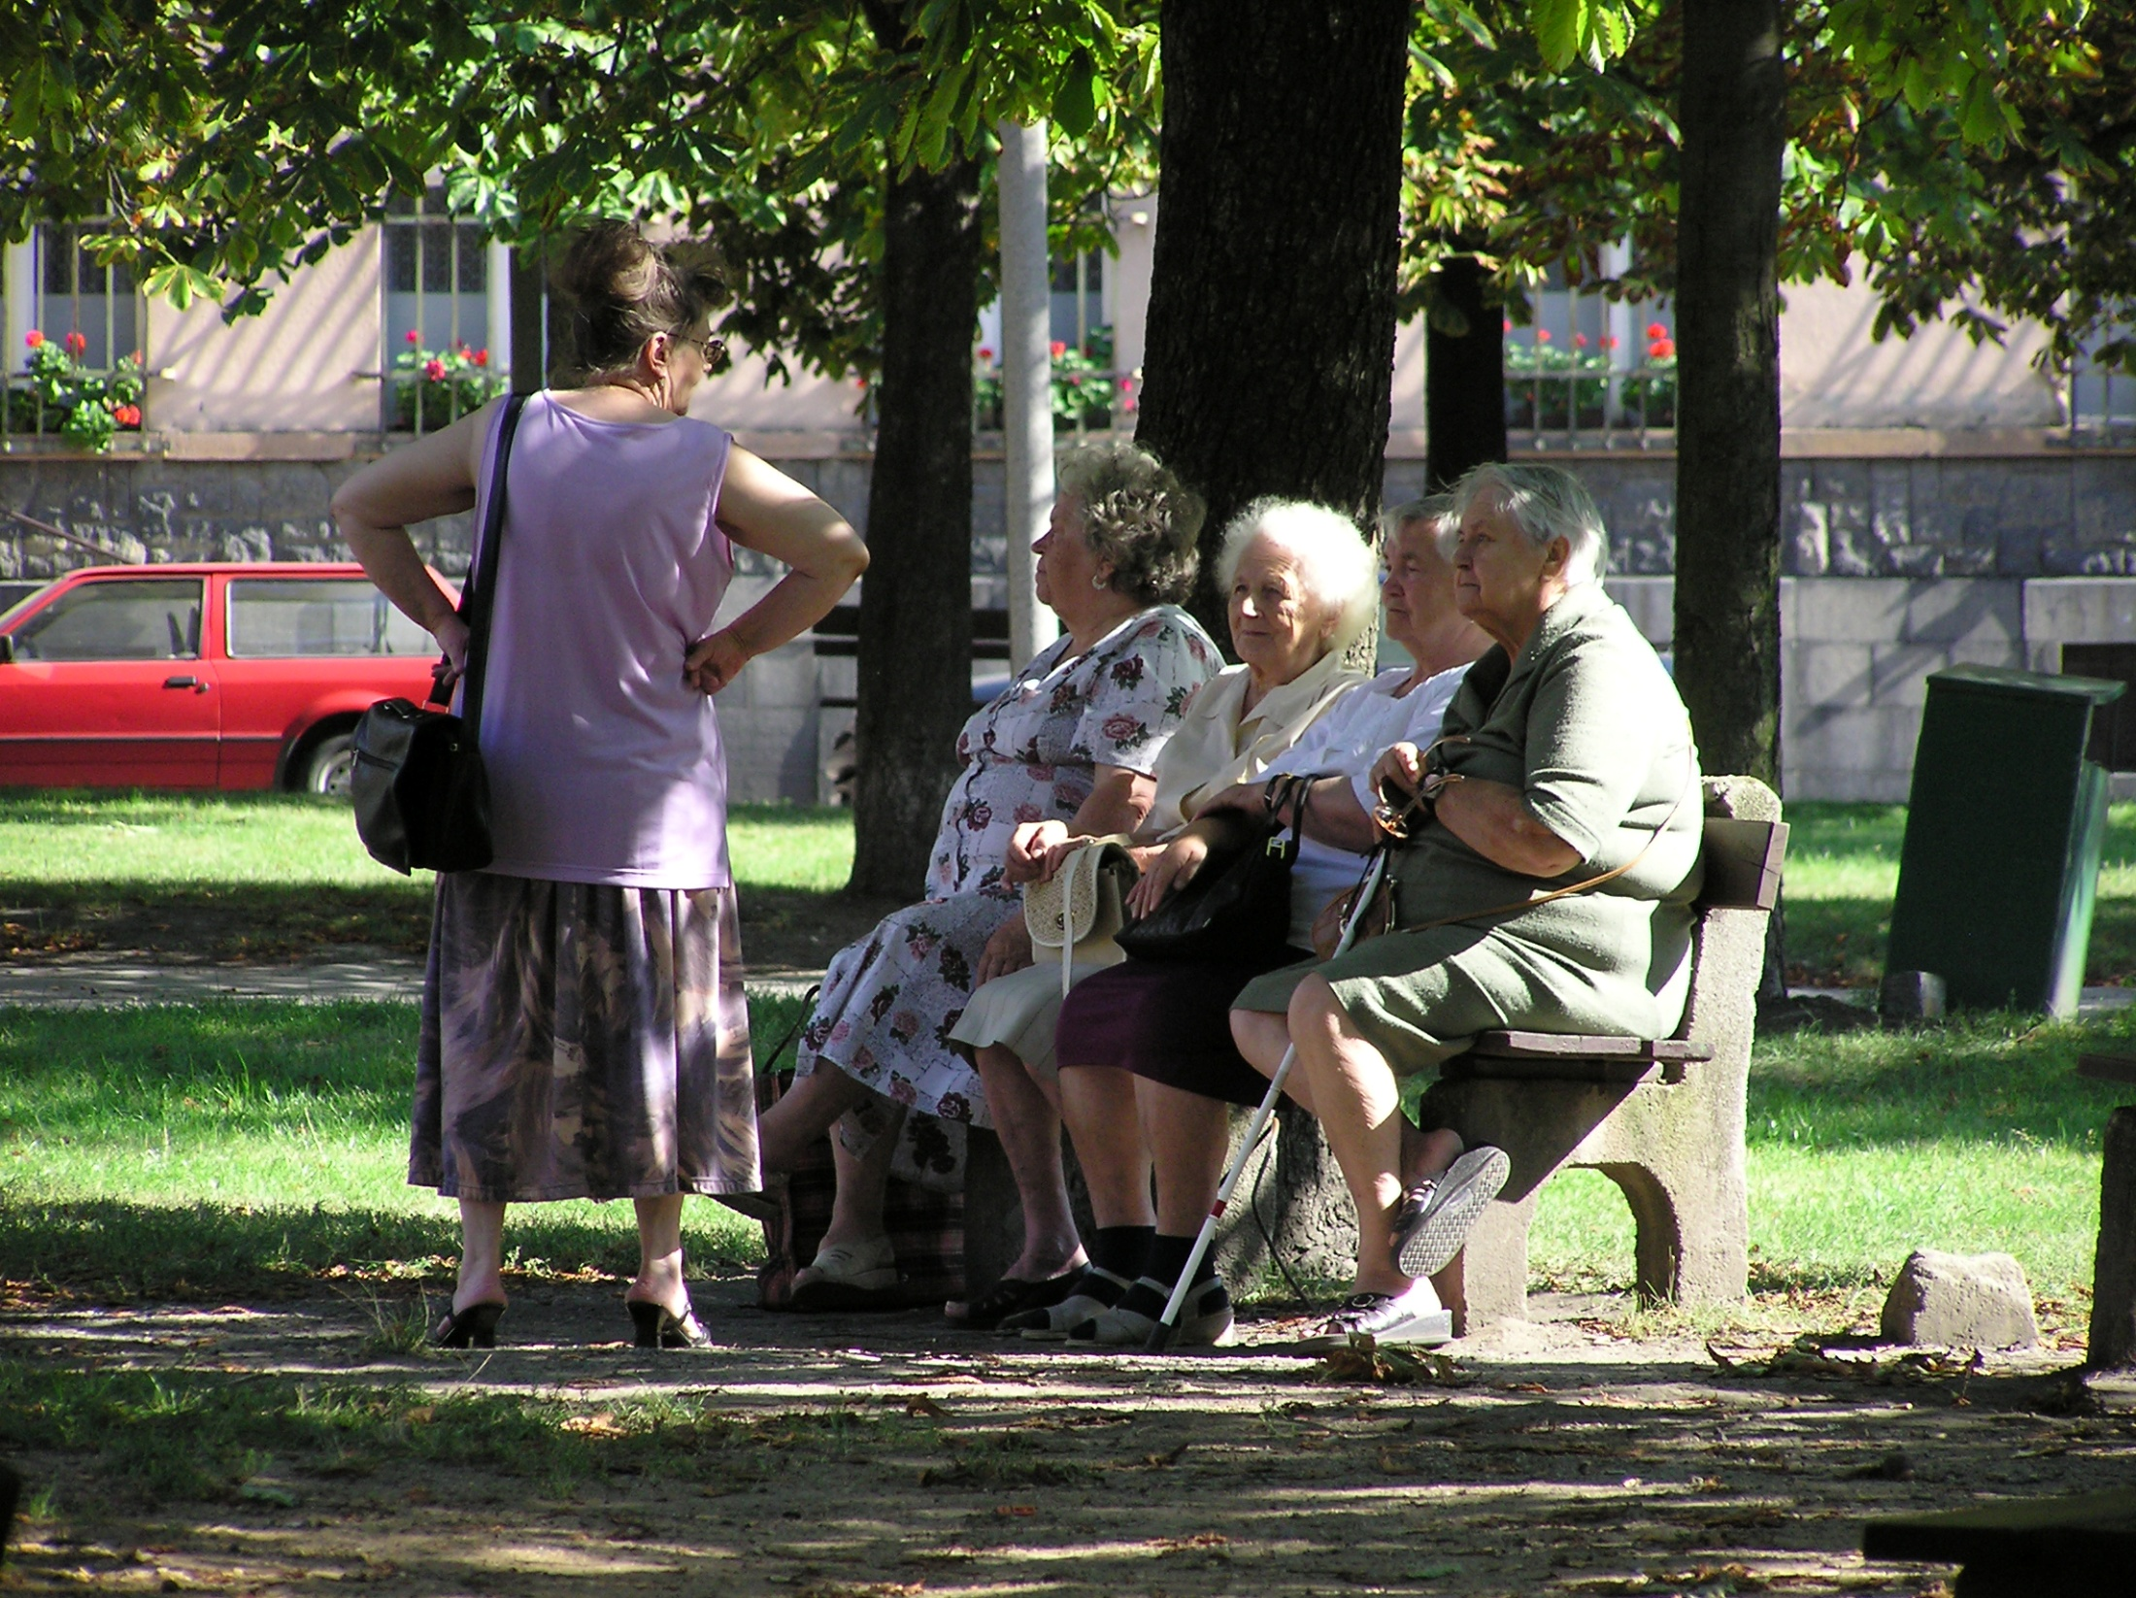
Property, Community, Crime & Well-Being
Decades of Research on
Property Values
Tourism
Direct Use
Health
Community Cohesion
Benefits of nature
Quantifiable & significant
Notes:
Urban communities are economic webs consisting of homes, commercial spaces, public buildings, transportation hubs and parks.
Decades of research has been done on the affect access to nature has on a community. The research has looked at a variety of factors including
property values,
tourism (including visits to city parks and park buildings that drive collective wealth),
direct use (recreational opportunities within parks),
health (savings in medical costs due to increased physical and mental health),
community cohesion (the avoidance of antisocial problems)
Based on this research and cost benefit analysis, we can quantify in dollars the importance of providing people with access to nature in the built environment and reveal the economic value of trees, parks, and other forms of nature in neighborhood design and urban planning.

Slide 51
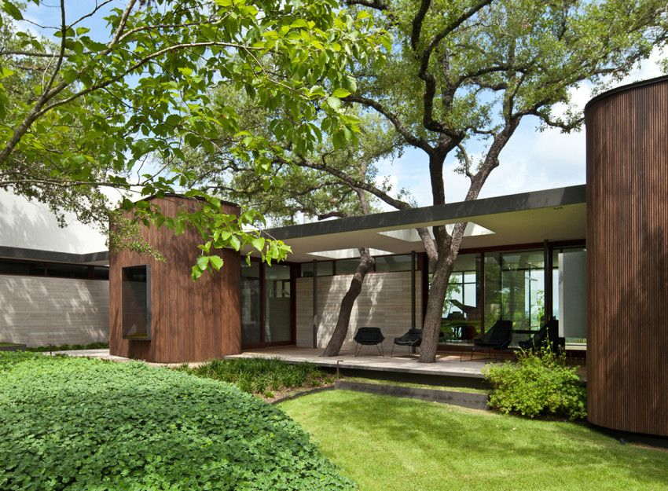
Increased Property Value
Notes:
Across the US people are willing to pay more for good views of distance, views of water, and views of large trees. These economics are relatively easy to measure.
Multiple studies have reported the following:
Good landscaping aesthetics coupled with large shade trees add an average of 7% to rental rates.
High quality landscaping increased the sale value of housing by 4-5% (Laverne & Winson-Geideman, 2003).
People will pay up to 127% more for a property with a view to water such as a bay or lake (Benson et al., 1998).
People will pay a 5% premium for on properties within 500 feet of a park.
People will pay up to 58% more for a property with a view to water and 127% more for a lakefront property (Benson et al., 1998).
This is not an uncommon trend in the real estate market. People are willing to pay for nature, validating its consideration during a project’s design phase.

Slide 52
Community Cohesion
Notes:
Community cohesion describes the feeling of closeness people have to their communities.
Housing developments with large trees have been found to attract people to be outdoors, engage with neighbors, and develop stronger social bonds (Heerwagen, 2006), which in lowers community tensions and aids social integration.
To measure social capital in economic terms, one study showed the financial value of park-specific volunteerism by quantifying the monetary value of volunteer hours, which in Philadelphia with its abundant park space, yielded a community cohesion value of $8.6 million (Harnik & Welle, 2009).
For 2015 study, the researchers measured the relationships between exposure to nature, community cohesion and crime rates. They asked a group of 2,000 participants from various communities to report on their access to nature, the amount of time spent in nature, and how much nature they can see from their homes. These responses were then pooled to come up with a measure of the community’s exposure to nature.
The results were striking: Contact with nature appeared to have a significant effect on promoting community ties and reducing violence.
Controlling for other factors such as socioeconomic deprivation, population density and unemployment, exposure to nature accounted for a full 8 percent of variance in community cohesion — meaning that people felt closer to their communities. To put that in perspective, individual factors such as age, income and gender together accounted for only 3 percent of the variation. (Weinstein, 2015)

Slide 53
Crime
CASE STUDIES CONCLUSIONS – ACCESS TO NATURE
Lower felony rate by 7-8%
Domestic violence less prevalent by 25%
Reduced hostility among prison inmates
Rough savings of $162,200 per year to Illinois Dept. of Corrections
Notes:
Even in prison environments, nature’s calming influence reduces mental fatigue, depression, anxiety and outbursts of anger.
Prison inmates, after participating in gardening projects, have shown reduced hostility.
Looking at community violence and crime in Chicago, researchers conducted a study of 145 public housing residents with varying proximity to nature.
Residents living in greener settings demonstrated higher scores in attention span and reliability.
Further, the study found that some types of domestic violence were 25% less prevalent in the greener housing developments (Kuo & Sullivan, 2001a).
Another 2001 study reported 52% fewer felonies in the greener buildings, 7-8 % of which could be linked to increased access to nature (Kuo & Sullivan, 2001b).
Applied across Chicago’s 12 family public housing developments, assuming that the rates of crime remain fairly consistent across each development, and assuming that each of these felonies resulted in arrest and incarceration, it is estimated that 52% fewer felonies results in a rough savings of $162,200 to the Illinois Department of Corrections each year (Chicago Housing Authority 2011, Durose & Langan 2003).

Slide 54
Wellbeing
CASE STUDIES CONCLUSIONS – ACCESS TO NATURE
Increased self-discipline in teenage girls
Notes:
The many physical and mental health benefits that access to nature provides both adults and children have been described in earlier in this presentation. We’ve learned how nature helps the brain reset itself, how our blood pressure becomes stabilized, and our capacity for creative problem solving is restored.
In closing I’d like to take a closer look at how biophilic design can improve the lives of our youngest and most vulnerable human beings.
As adult role models and stewards of their world, it is incumbent upon us to provide growing children with environments that help them develop healthfully and meet their psychological needs.
In a study of teenage girls, researchers found that those with green space immediately outside their homes demonstrated more self-discipline than those without, by a margin of 20%. Self-discipline was measured as a function of concentrating, inhibiting initial impulses, and delaying gratification (Taylor et al., 2001).
Mastery of these personal skills often results in higher rates of professional, academic and personal success.

Slide 55
Wellbeing
CASE STUDIES CONCLUSIONS – ACCESS TO NATURE
Reduced medical costs related to obesity treatment
Superior treatment results of young ADHD and ADD patients
Notes:
In one generation – just 30 years – kids are getting outdoors half as often as their parents, while child obesity rates have tripled and the use of Ritalin to address ADHD has skyrocketed.
Outdoor activities, rather than drug prescriptions, have been identified as a means of treatment for obesity and have been championed by medical professionals.
10% of the nation’s medical costs (c.$150 billion) is attributed directly to obesity. $2,200 per person per year can be reduced if sedentary individuals become more physically active three or more days per week.
Nature has major implications for the way we treat for ADD and ADHD. Children with ADHD who take a 20-minute walk through a park are likely to exhibit significantly better concentration than by doing the same walk in a downtown area with no greenery.
If exposure to nature could be used as a way to minimize symptoms of ADD and ADHD in children, a 10% reduction in spending on this medication would result of savings of $228 million annually.

Slide 56
How do we encourage Biophilic Design with decision makers?
Notes:
A few quick slides summarizing the previously discussed economic benefits of biophilic design

Slide 57
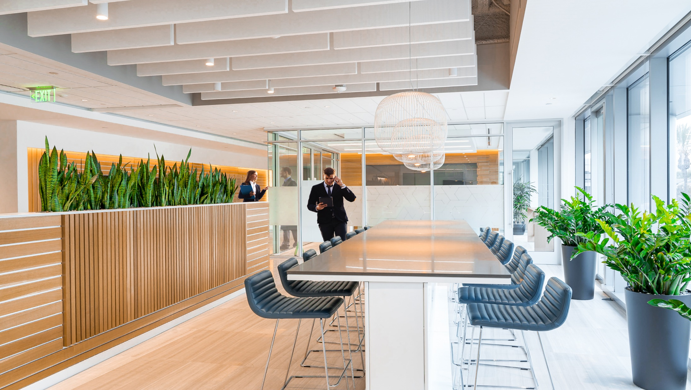
Employers
IMPACT of BIOPHILIC DESIGN
Views and access to nature provide:
Reduced absences (10%)
Increased productivity (12%)
Higher levels of wellbeing (15%)
Higher levels of creativity (15%)
Improvements in concentration (19%)
3:1 return on initial investment

Slide 58
Medical Facilities
Impact of Biophilic Design
Most Suitable Patterns
Post-Surgery
20% less painkillers
8.5% shorter hospital stays
Chemotherapy
Increased effectiveness of treatments
Depression
Shorter stays of 3.5 days
Staff and Patients
Decreased anxiety, stress
Improved mood, outlook, co-operation
Visual Connection to Nature
Refuge

Slide 59
Education
Impact of Biophilic Design
Most Suitable Patterns
School Curricula
20-26% faster progression
Improved attendance (3.5 days)
Improved attention
ADHD symptoms reduced
Improved test scores (15-18%)
Improved self discipline
Ecological literacy & Environmental Values
Social skills
Less stress
Connection to Natural Systems
Peril
Visual Connection to Nature

Slide 60
Retail
Impact of Biophilic Design
Most Suitable Patterns
Consumers willing to pay 25% more
Longer duration spent in store
Higher frequency of repeat business
Buffers stress of shopping
Prospect
Mystery
Refuge

Slide 61
Housing Developers
Impact of Biophilic Design
Most Suitable Patterns
Property price increases
Forest views 7%
View of water features 5%
Waterfront 58%
Large trees 7%
Landscaping 5%
Nearby park 5%
Views to nearby park 37%
Place attachment
Stewardship
Visual Connection to Nature
Presence of Water
Connection with Natural Systems

Slide 62
Communities
Impact of Biophilic Design
Most Suitable Patterns
Reduced health inequalities
Increased longevity
Reduced stress
Community cohesion
Reduced violence/aggression (25%)
Reduced crime (8%)
Increased self discipline among youth (20%)
Visual Connection to Nature
Connection with Natural Systems
Refuge

Slide 63
Let’s Move Forward with Biophilic Design
Notes:
Humans have evolved and progressed alongside nature and its systems.
Because of this, the human mind and body function with improved efficiency when natural elements are present.
This statement is supported by research from neuroscience and endocrinology which shows the crucial role that experiencing nature has for our physiological well-being.
Biophilic design optimizes productivity, healing time, learning functions, and community cohesion as the perfect partnering mechanism for business vendors, hospital owners, school administrators, contractors, and city planners alike who are seeking to reap maximum value through development and design.
Implementing biophilic design into our workplaces, healthcare system, educational environments and communities is not just a nice amenity. It has profound economic benefits. It is now imperative that we bring nature into our built environment.
The benefits of biophilia include improved stress recovery rates, lower blood pressure, improved cognitive functions, enhanced mental stamina and focus, decreased violence and criminal activity, elevated moods, and increased learning rates.
From the evidence presented, biophilic elements show productivity increases among staff when provided with nature in the workplace, with economic benefits ranging from $1,000 per employee to $3.6 million company-wide.
In the $2.5 trillion healthcare industry, simply increasing views from hospital beds to nature could yield over $93 million in annual savings nationwide as patients require less time in the hospital to recover from major surgery.
The significant nationwide healthcare savings in recovery from these surgeries alone indicates that testing the effects of biophilia in other areas of healthcare is a worthwhile and potentially lucrative endeavor.
Retail shops with natural greenery and daylighting consistently yield higher profit margins than their dim counterparts, offering a 12% competitive advantage for shops with more greenery and 40% for quality daylighting.
Children, the most vulnerable yet influential members of society, have been found to improve their test scores by 7-26% and have fewer absences from school when they are given access to daylighting.
The network of communities that span the United States can economically benefit from the presence of nature, as a result of access to park space, while also encourage less crime and less need for medication within community inhabitants.

Slide 64
Thank you for inviting me to share this information with you!
Receiving continuing education credit for today’s program?
Be sure you have signed the registration roster and completed your program evaluation.
Upon receipt of your program evaluation, you will receive a certificate of course completion.
Other resources are available on www.gpgb.org.
Photo: Jim Mumford, Good Earth Plant Co. & GreenScaped Buildings, San Diego.
Notes:
This concludes our presentation today. Thank you so much for your time and attention. Do you have any further questions or comments?
Photo: Jim Mumford, Good Earth Plant Co. & GreenScaped Buildings, San Diego.

Slide 65
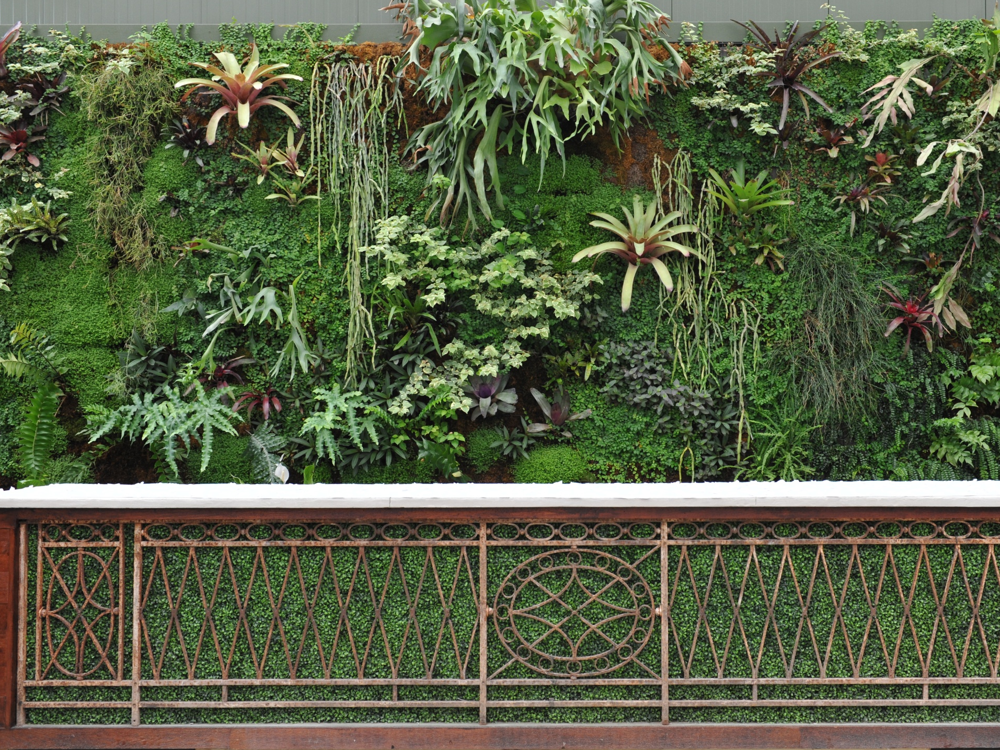
Looking for more Continuing Education?
Authentically Green Interiors – Optimizing Nature’s Design
Living Walls – An Introduction
Living Walls – Case Studies
Green Roofs
The Economics of Biophilic Design
Moss Walls – A Biophilic Design Solutions
Biophilic Design in Fitwel, the WELL Building Standard, and
the Living Building Challenge
Learn more or donate at gpgb.org.
Photo: McRae Anderson, McCaren Designs, St. Paul, MN. Location: Planterra, West Bloomfield, MI
Notes:
Photo: McRae Anderson, McCaren Designs, St. Paul, MN. Location: Planterra, West Bloomfield, MI

Slide 66
Expanding our marketing conversations
Wellness matters!
Let’s put more plants into
human spaces

Slide 67
Looking for an interior landscape specialist?
To connect with a specialist visit:
https://greenplantsforgreenbuildings.org/supporters
Notes:
Display this slide if presenting to USGBC or use the following slide if appropriate.

Slide 68
Add information about your company here.
Project slides
Scope of services
Awards you have won
Professional credentials
Notes:
Add compelling information about your company to this slide.
Switch the slide image to a memorable image that represents your company’s professionalism and status as an industry thought-leader.

